Slide 1
Cryptography
(Cryptography)

Slide 2
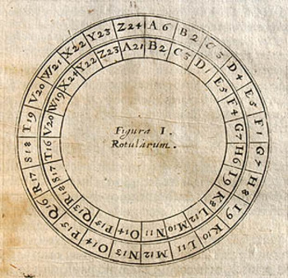
the basics
cryptography deals with techniques for secure communication in the presence of third parties (adversaries).
modern cryptography uses
mathematics, computer science,
and electrical engineering
the word “cryptography” originates
from two Greek words:
“hidden/secret” and “writing”

Slide 3
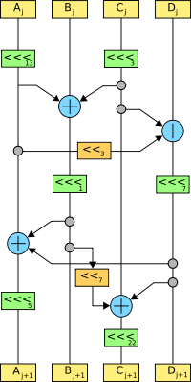
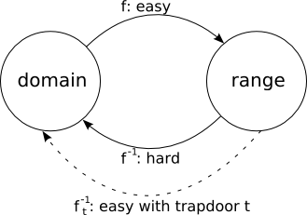
cipher systems
a cipher is the algorithm that transforms information
symmetric vs. asymmetric
serpent

Slide 4
the olden days
cryptography was basically encryption
information -> nonsense -> information
whoever wrote the message provided the recipient with the decoding key

Slide 5
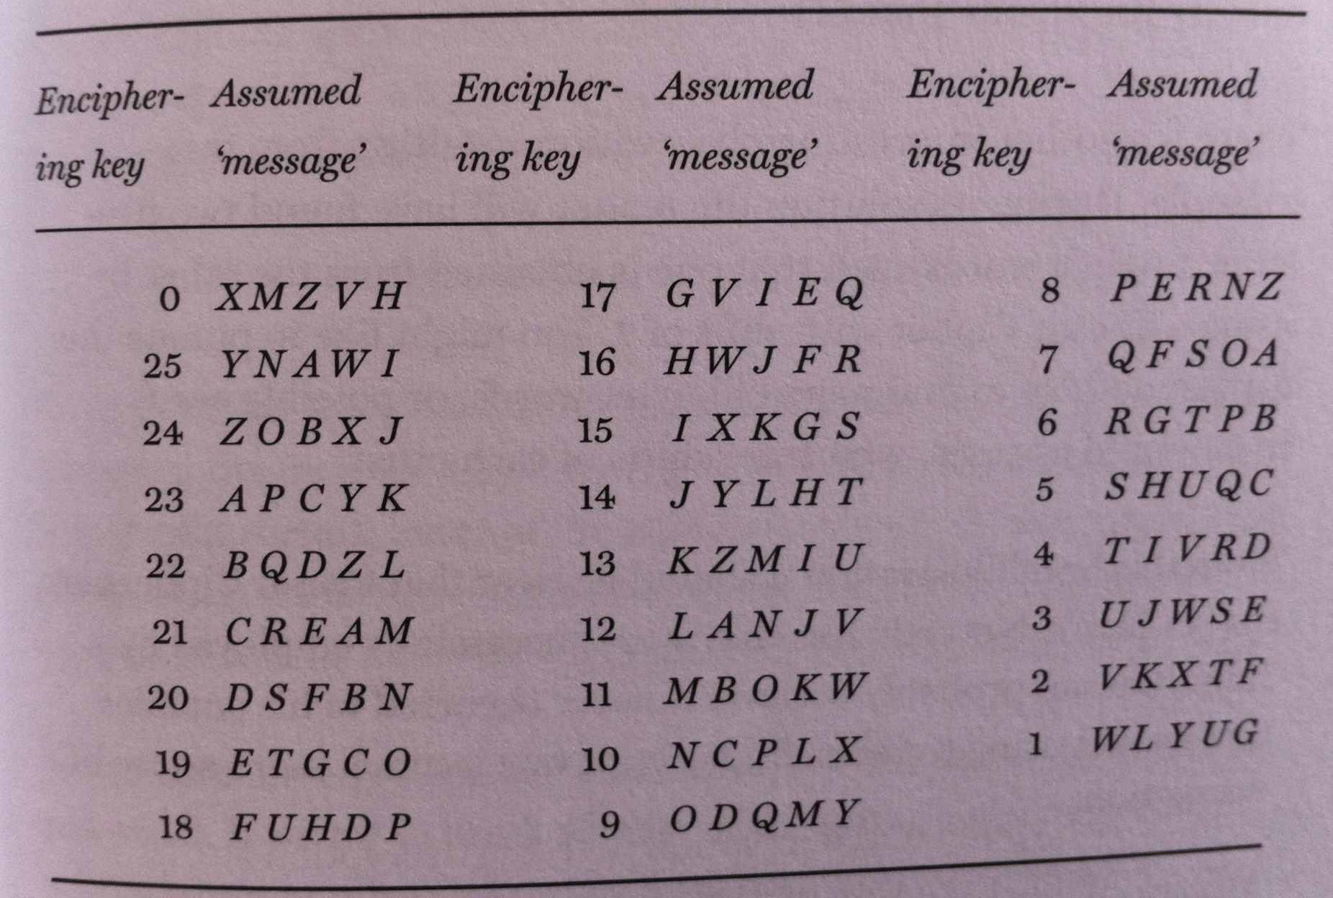
exhaustive key search on a Caesar Cipher
code = XMZVH

Slide 6
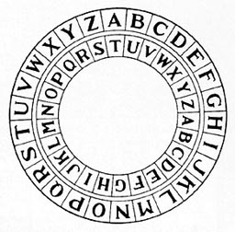
modular arithmetic
in a Caesar Cipher, a shift of 26 is the same as a shift of 0.
for example: 37 = 11(mod 26)

Slide 7
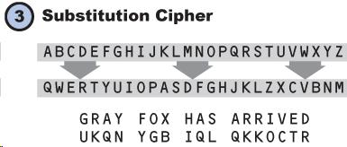
we want a large number of keys
(but having lots of keys is no guarantee of a strong system)
number of potential keys = number of ways 26 letters can be arranged
26! = 403,291,461,126,605,635,584,000,000

Slide 8
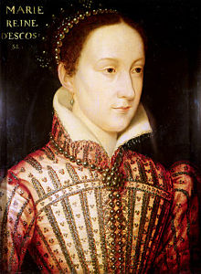
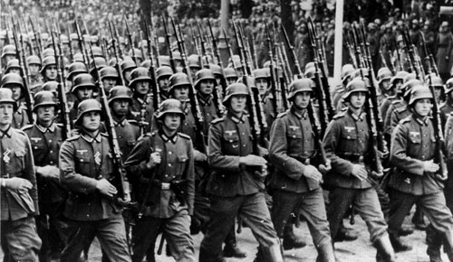
a large number of keys does not guarantee that a cipher is unbreakable
German Armed Forces, WWII
Enigma Machine
Mary, Queen of Scots
1542 - 1587

Slide 9
Diffie-Hellman Key Exchange

Slide 10
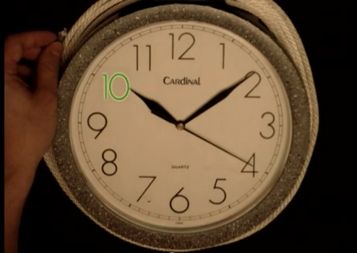
asymmetric cipher systems and more modular arithmetic

Slide 11
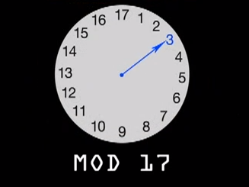
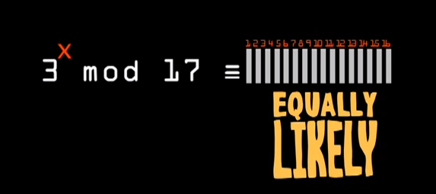
the primitive root of 17 is a number that has no factors in common (3)

Slide 12
