Slide 1
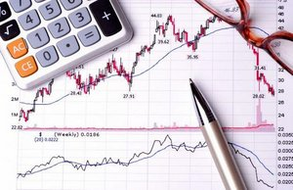
MATHEMATICAL ECONOMICS
And its Applications

Slide 2
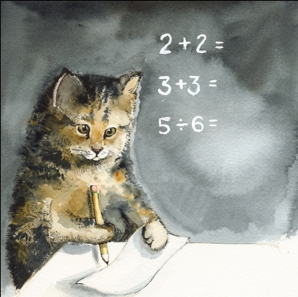
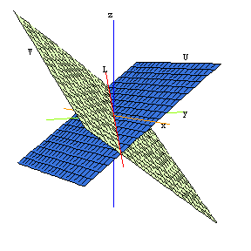
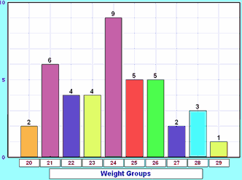
MATH TOPICS IMPORTANT TO ECONOMICS

Slide 3
LINEAR ALGEBRA!
Input Output Matrices
Demonstrate how goods from one industry are consumed in other industries.
Rows of the matrix represent producing sector of the economy
Columns of the matrix represent consuming sector of the economy
One vector of the matrix represents the internal demand
Models what would happen if a producer increases or decreases the price of a good

Slide 4
EXAMPLE OF INPUT OUTPUT MATRIX
( )
S₁
S₂
.
.
.
S_{n}
S₁ S_{2 . . .} S_{n}
a₁₁ a₁₂ . . . a_{1n}
a₂₁ a₂₂ . . . a_{2n}
. . .
. . .
. . .
a_{n1} a_{n2} . . . a_{nn}
The entry a_{ij} represents the percent total production value of
sector j is spent on products of sector i

Slide 5
CALCULATING AMOUNT OF A GOOD PRODUCED
[ ] = [ ] + [ ]
Amount
produced
Internal
demand
Final
demand

Slide 7
DUALITY
Refers to connections between quantities and prices that arise as a consequence of the hypotheses of optimization and convexity
Derives convex functions involving mappings and vectors to determine cost, profit, and production
Finds an equilibrium of the market and optimal values of supply and demand
Involves proofs of several lemmas (Hotelling’s lemma and Shephard’s lemma to name a few!)

Slide 8
FOUNDATIONS STYLE PROOF!!!
Hotelling’s Lemma
Result of duality
Asserts the net supply function of good i as the derivative of the profit
function with respect to the price of good i
If (x, y) ∈ nm(p, w) = ndF∗(p, w), then (p, w) ∈ ndF∗∗(x, y) = ndF(x, y).
Then dF(x, y) + (p, w) · ((x′, y′) − (x, y)) ≤ dF(x′, y′) for all (x′, y′).
This implies that x ∈ F and furthermore that (p, w) · ((x′, y′) − (x, y)) ≤ 0 for all (x, y) ∈ F, in other words, that (x, y) is profit-maximizing at prices (p, w). Conversely, suppose that (x, y) is profit maximizing at prices (p, w).
Then (p, w) satisfies the subgradient inequality of dF at (x, y), and so (p, w) ∈ ndF.
Consequently, (x, y) ∈ ndF∗(p, w) ≡ nm(p, w).

Slide 9
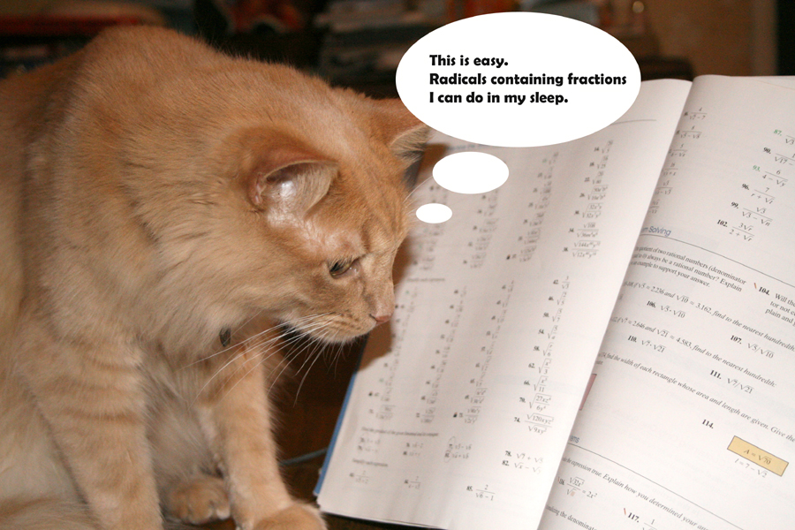

Slide 10
GAME THEORY
The Science of Strategy
Started by Princeton mathematician John Von Neumann
Mathematically & logically determines the actions that “players” should take for best personal outcomes in a wide array of “games”
Mathematically analyzes interdependence of player strategy to optimize gains
Interdependent strategies can be sequences or simultaneous functions

Slide 11
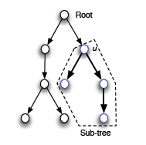
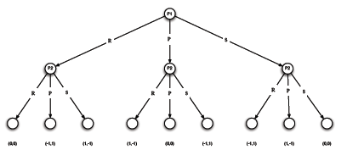
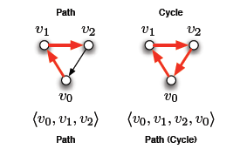
MATHEMATICAL CONCEPTS IN GAME THEORY
Linear Algebra
Example: Saddle Points and Zero-Sum Games
In zero-sum games, the winner’s gains are equal to the loser’s loss, resulting in a “zero-sum”.
Game choices can be represented by matrices whose vectors are manipulated to calculate saddle points: equilibrium strategy pairs (x, y).
Theorems and their Proofs
Some prominent theorems proved in Game Theory include:
Bayes Rule
Expected Utility Theorem
Zermelo’s Theorem
Minimax Theorem
Brouwer Fixed Point Theorem
Nash Equilibrium Theorem
All of these involve a foundations style proof!!!
(See resource guide for links to proofs!)
Probability
Example: Die Rolling Game
You put up your own money; even rolls lose $10 * the roll, odd rolls win $12 * the roll. Should you play?
This specific example involves random variables, mean, and calculation of the expectation.
Other aspects of game theory, however, include power sets, conditional probability, union and intersection of probability, Bayes Rule, and more!
Set Theory
Example: Utility Theory
Utility theory mainly involves Lotteries:
L = {{A₁, A₂, …, A_{n}}, p}
A lottery is a set containing all possibilities of outcomes and their respective probabilities.
Unions, intersections, difference, Cartesian products, and power sets are all used to calculate the optimal choices for players in a given game.
Trees and Graphs
Used to map possible choices and their resulting outcomes.
Examples include:
Probability
Set Theory
Trees and Graphs
Linear Algebra
Theorems and their Proofs

Slide 13
EXAMPLE OF OUR COURSEWORK IN ECONOMICS

Slide 14
PROOFS IN ECONOMICS?!?! DUH!
Envelope Theorem
General principle describing how the value of an optimization problem changes as the parameters of the problem change

Slide 15
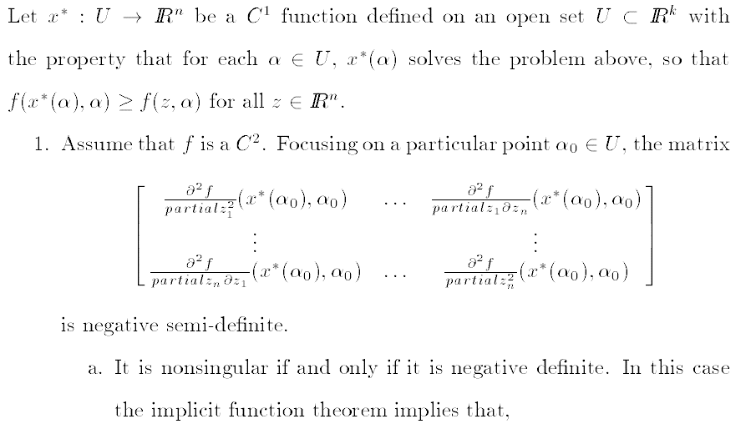

Slide 16
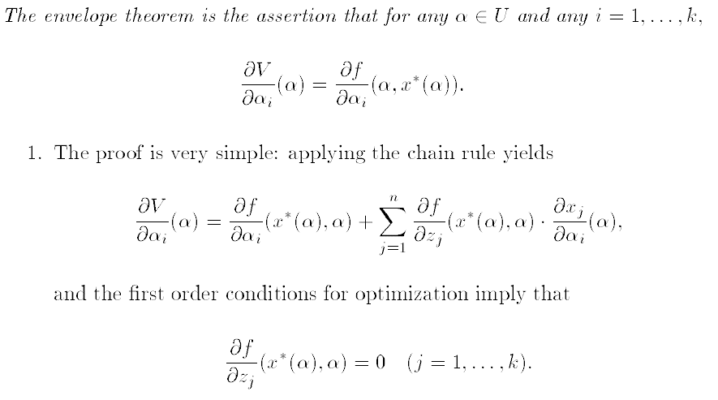

Slide 18
MATHEMATICAL ECONOMICS AFTER COLLEGE

Slide 19
ACTUARIAL SCIENCE
Actuaries:
Evaluate the likelihood of future events using numbers
Design creative ways to reduce the likelihood of undesirable events
Decrease the impact of undesirable events that do occur
Recommended Coursework:
Microeconomics, macroeconomics, calculus, linear algebra, calculus-based probability and statistics, actuarial science courses as available, computer science courses
Money:
Experienced actuaries can make between $150,000 and $250,000 per year!!!

Slide 20
RISK MANAGEMENT
Risk Managers:
Asses business risks
Take measures to control or reduce risks
Recommended Degrees:
Risk management, finance, mathematics, economics, business
Money:
Average salary for risk managers is $104,000 with experienced risk managers earning up to $170,000

Slide 21
BUDGET ANALYSIS
Budget Analysts:
Establish the relationships between resources and the organization's mission and functions
Analyze accounting reports
Write budget justifications
Examine budgets and financial plans
Recommended Degrees:
Accounting, finance, business, economics, statistics, mathematics, political science, or sociology.
Money:
Average salary for beginners is $70,000

Slide 23
MATHEMATICAL ECONOMICS AT WILLIAM AND MARY

Slide 24
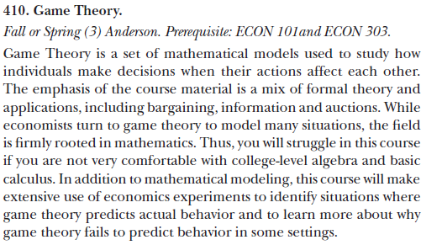
COURSES

Slide 25
PROFESSORS
Professor Moody
Courses:
Econometrics
Mathematical Economics
Time Series Analysis
Topics in Mathematical Economics
Research:
Economics of Crime – the econometric analysis of crime and criminal justice policy
Professor Anderson
Courses:
Game Theory
Experimental Economics
Research:
Nash Equilibrium – survey of recent experimental findings in oligopoly markets

Slide 26
RESOURCES
Readings on Linear algebra
http://www.math.dartmouth.edu/archive/m22f06/public_html/leontief_slides.pdf
http://www.math.unt.edu/~tushar/S10Linear2700%20%20Project_files/Davidson%20Paper.pdf
http://www.math.unt.edu/~tushar/S10Linear2700%20%20Project_files/Davidson%20Present.pdf
Reading on Duality
http://tuvalu.santafe.edu/~leb/Duality2.pdf
Readings on Game Theory
http://www.econlib.org/library/Enc/GameTheory.html
http://www.personal.psu.edu/cxg286/Math486.pdf
http://www.gametheory.net/popular/reviews/ChickenMovies.html
http://www.pitt.edu/~jduffy/econ1200/Lectures.htm
The Envelope Theorem
http://cupid.economics.uq.edu.au/mclennan/Classes/Ec5113/ec5113-lec13-3.4.99.pdf

Slide 27
RESOURCES, CONT.
Info on Actuarial Science
http://www.beanactuary.org/study/?fa=education-faqs
http://actuarialgrads.com/actuaries%20-%20US%20Dept%20of%20Labor%20Occupational%20Handbook%20Information.htm
Info on Risk Management
http://financecareers.about.com/od/compliance/a/riskmanager.htm
Info on Budget Analysis
http://www.budgetanalyst.com/careers.htm
http://www.bls.gov/ooh/business-and-financial/budget-analysts.htm
Mathematical Economics at William and Mary
http://www.wm.edu/as/economics/documents/handbook_2011.pdf
http://www.wm.edu/as/mathematics/undergrad/major/appliedmath/index.php: “To a large degree, economics and finance are now the study of specialized mathematical models, and the social sciences use game theory, probability, and statistics as the organizing tools for much of their research. The same is true of industrial applications. Without the insights of operations research, modern industry would not be able to achieve the levels of efficiency required to prosper”
http://mason.wm.edu/programs/undergraduate/admissions/requirements/index.php
http://www.wm.edu/offices/registrar/documents/catalog/catalogbydept/economics.pdf
https://catalog.swem.wm.edu/Record/1088186

