Slide 1
Fermat’s Last Theorem
Jonathan Rigby

Slide 2
Fermat’s last theorem
x^{n}+y^{n}=z^{n}
Fermats proof by infinite descent
x⁴⁺+y⁴=z⁴

Slide 3
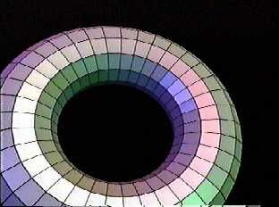
Elliptic curves
Cubic curve who’s solution looks like a donut
All points on the donut is the solution to the initial equation

Slide 4
Modular form
A function on the Complex plane, which satisfies a certain kind of function equation and growth condition.
They exhibit many symmetries

Slide 5
Tanyama Shimora Conjecture
Claim that all elliptic curves are modular forms

Slide 6
Epsilon conjecture
Consider if x^{n}+y^{n}=z^{n} has a solution.
Create an elliptic curve using this function.
The resulting elliptic curve appears to not be modular

Slide 7
Problem
Show a particular elliptic equation is paired with a modular form.
Show all elements in E have a corresponding element in M
Mathematical induction
Repeat this process for the infinite number of elliptical and modular equations.

Slide 8
Galois representation
Group theory
Groups built on the division of solutions to equations into packets with similar properties.
Transforming the elliptical curve equations into packets that could be matched up to modular forms

Slide 9
Class Number Formula
Flach Kalyvargan
Iwasawa Theory

