Slide 1
MATH2999 Directed Studies in Mathematics Quantum Process on One Qubit System
Name: Au Tung Kin
UID: 2009264740

Slide 2
Abstracts
Background
Quantum system of Mixed Quantum States
Program of Constructing TPCP Map
Special Techniques in Program
Acknowledgements
Reference

Slide 3
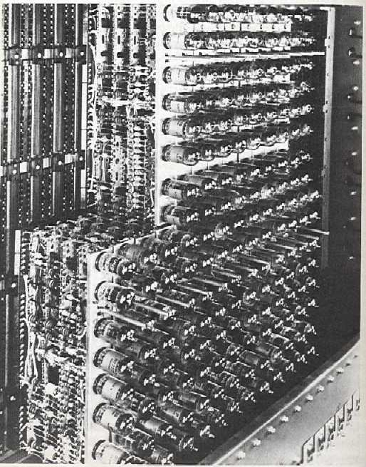
Background: History & New Hope
1st Generation
Vacuum Tubes
3rd Generation
Integrated Circuits (IC)
2nd Generation
Transistor
Quantum Computer!!!
Computer
in the future?
5th Generation
Artificial Intelligence (AI)
4th Generation
Microprocessor

Slide 4
Background: Quantum Computer VS Classical Computer
Comparisons between UNIT for storing information
Qubit
Bit
Represent “1” or “0”
Represent “1” or “0” ONLY
e.g. Circuit Signals
e.g. Spin of electrons
Superposition of “1” and “0”
0
0
0
1
1
1

Slide 5
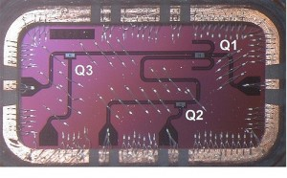
Background:
Quantum Computer
Qubit: the unit of storing information
Three superconducting
qubits.
Credits: IBM research
Quantum Operations
Unitary Transformation
Unitary Linear Mapping :C² → C² vector space
e.g.
A unitary transformation Pauli-x Operation
i.e. σ_{x} transforms “1” to “0”
i.e. σ_{x} transforms “0” to “1”
σ_{x} : Quantum NOT Gate

Slide 6
Quantum system of Mixed Quantum States
Experiment
Interesting Situations
time = 0
time = t
Time
We know the state
!!!Experimenter performs operations on the original state!!!
We (included the experimenter)
do NOT know the operations
Environment
Answer:
The new state can be describe by density matrix

Slide 7
Quantum system of Mixed Quantum States
Interesting Situations
time = 0
time = t
Time
We know the probability of the state at time t:
e.g.
The New State (MIXED)
at time t:
(2x2 Density Matrix)

Slide 8
Quantum system of Mixed Quantum States
Given 2x2 density matrices
A₁ , A₂ , A₃ , A₄ ∈ H_{2x2}
B₁ , B₂ , B₃ , B₄ ∈ H_{2x2}
Does a linear TPCP map T: H_{2x2} → H_{2x2}
s.t. T(A_{i})=B_{i} always exists?
Can we describe the operations in mathematics?
Interesting Situations
Experiment
time = 0
time = t
Time
Environment
The operations on density matrices:
Trace-Preserving
-Completely-Positive linear map
(TPCP map)
A linearly completely positive map is trace-preserving:

Slide 9
Program of Constructing TPCP Map
A program was developed
Given density matrices as
domain elements and
images
Construct a linear TPCP map
if it exists
Show notice
if TPCP map does not exists

Slide 10
How to Construct TPCP Map?
Given n density matrices,
A₁, A₂, … , A_{n} ∈ H_{2x2}
TPCP Map T: H_{2x2} → H_{2x2}
↓
↓
↓
B₁, B₂, … , B_{n} ∈ H_{2x2}
are their corresponding images
Procedure 1:
Find out all linearly independent A_{i}’s
Procedure 2:
Check linear coefficients preserve
among A_{i}’s and B_{i}’s
Procedure 3:
Construct TPCP map
for linearly independent A_{i}’s
and corresponding B_{i}’s

Slide 11
How to Construct TPCP Map? Procedure 2: Linear Coefficient Preserve
2nd Step
Check linear coefficient preserve or not
e.g. Suppose where
and A₄ is dependent of and
Necessary Condition!
i.e. A₃ = α₁ + α₂
⇒ B₃ = α₁ + α₂
Hence, if A₃ = α₁ + α₂
But B₃ ≠ α₁ + α₂
Then linear map for
T(A_{i}) = B_{i} must not exist!

Slide 12
How to Construct TPCP Map? Procedure 3: TPCP Map for Linearly Independent
Let k be the number of linearly independent A_{i}’s
Since are A_{i}∈ H_{2x2}
where H_{2x2} is a vector space with dimensions 4
k can be at most 4
Divide k into 4 cases
k = 1
k = 2
k = 3
k = 4

Slide 13
How to Construct TPCP Map? Procedure 3: TPCP Map for Linearly Independent
Case 1: k = 1
Given A₁ , B₁ ∈ H_{2x2}
Find a TPCP map T : H_{2x2} → H_{2x2}
s.t. T(A₁) = B₁
TPCP map T : H_{2x2} → H_{2x2}
T(X) = trace(X) B₁

Slide 14
How to Construct TPCP Map? Procedure 3: TPCP Map for Linearly Independent
Case 2: k = 2
Given A₁ , A₂ , B₁ , B₂ ∈ H_{2x2}
Find a TPCP map T : H_{2x2} → H_{2x2}
s.t. T(A_{i}) = B_{i} for i = 1, 2
A₁ =
where x₁ is 2x1 column vector with norm 1
A₂ =
where x₂ is 2x1 column vector with norm 1
B₁ =
B₂ =

Slide 15
How to Construct TPCP Map? Procedure 3: TPCP Map for Linearly Independent
Case 2: k = 2

Slide 16
How to Construct TPCP Map? Procedure 3: TPCP Map for Linearly Independent
Case 2: k = 2
Put X = A₁ = x₁ x₁*
+
B₁

Slide 17
How to Construct TPCP Map? Procedure 3: TPCP Map for Linearly Independent
Case 2: k = 2
Put X = A₂ = x₂ x₂*
+

Slide 18
How to Construct TPCP Map? Procedure 3: TPCP Map for Linearly Independent
Case 3: k = 3
Given A₁ , A₂ , A₃ , B₁ , B₂ , B₃ ∈ H_{2x2}
Find a TPCP map T : H_{2x2} → H_{2x2}
s.t. T(A_{i}) = B_{i} for i = 1, 2, 3
A₁ =
where x₁ is 2x1 column vector with norm 1
A₂ =
where x₂ is 2x1 column vector with norm 1
A₃ =
where x₃ is 2x1 column vector with norm 1
x₃

Slide 19
How to Construct TPCP Map? Procedure 3: TPCP Map for Linearly Independent
Case 3: k = 3
If there exists a 2x2 matrix C s.t.
1. trace(CC*) = 1+|det(C)|² ≤ 2
2.
3.

Slide 20
How to Construct TPCP Map? Procedure 3: TPCP Map for Linearly Independent
Case 4: k = 4
Given A_{i} , B_{i} ∈ H_{2x2} for i = 1, 2, 3, 4
Find a TPCP map T : H_{2x2} → H_{2x2}
s.t. T(A_{i}) = B_{i} for i = 1, 2, 3, 4
There is one unique linear map T : H_{2x2} → H_{2x2}
If the unique linear map satisfy
1. Trace-Preserving
2. Completely-Positive
It is the required TPCP map!
is positive semi-definite or not

Slide 21
Acknowledgements
Thank all for coming this seminar!
Thank all for your kind attention!
Besides,……
Thank Prof. Li,
Prof. Poon,
Dr Chan and
Dr Cheung
for their support!!!

Slide 22
Reference
Timeline of computer chronicle
http://www.engineerspark.com/2012/01/timeline-of-computer-chronicle/
IBM makes significant breakthrough towards scalable quantum computers
http://www.zmescience.com/research/ibm-quantum-computer-28022012/
The atomic structure of individual nanoparticles
http://nycgrp.wordpress.com/2011/05/18/

Slide 23
Reference
Environment
http://informedfarmers.com/nrm/environment/
File:Military laser experiment.jpg
http://en.wikipedia.org/wiki/File:Military_laser_experiment.jpg

Slide 24
THE END!

