Slide 1
PageRank and Vote
Edmond Kwok

Slide 2
Google as a searching engine

Slide 3
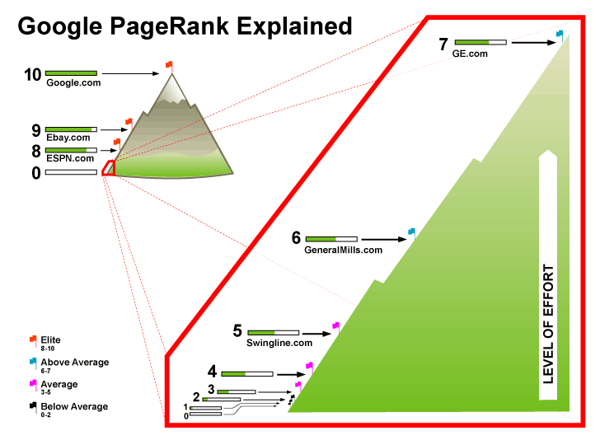
Google Algorithm
PageRank
1 to 10

Slide 4
Google Algorithm in Math

Slide 5
5-Page Situation

Slide 6
4 Rules
He will start with any random page by typing the URL directly in the browser.
Whenever he reaches a particular page, he will randomly click the outboard links provided in the current page and login to that corresponding page.
He will never get tired, which means he keeps repeating process in rule 2.
If he reaches the dangling pages, he will close the browser and restart with process in rule 1.

Slide 7
Background of Google PageRank Algorithm
Hyperlink Matrix
L(i) is the total number of outboard link from page i.

Slide 9
Homepage Vector
Dangling Node Vector

Slide 10
Close Cycle

Slide 11
Google Matrix (Discrete Markov Chain)
α : Damping Factor
E : Teleportation Matrix
Row stochastic and irreducible
G depends more on E if α decreases

Slide 12
PageRank vector
Stationary distribution vector
Long term distribution of the pages that the ideal user will stay on.
Calculated by power method

Slide 13
Summary of Symbols

Slide 14
Effect of Adding A New Page to The Original System

Slide 15
Effect of Adding A New Page to The Original System
If α = 1, then G will reduce to S and it may not be irreducible.
If α = 0, then G=E
Assume 1> α>0

Slide 16
Low Dimension Case
assuming a, b not both equal to 1

Slide 17
Proposition 1

Slide 18
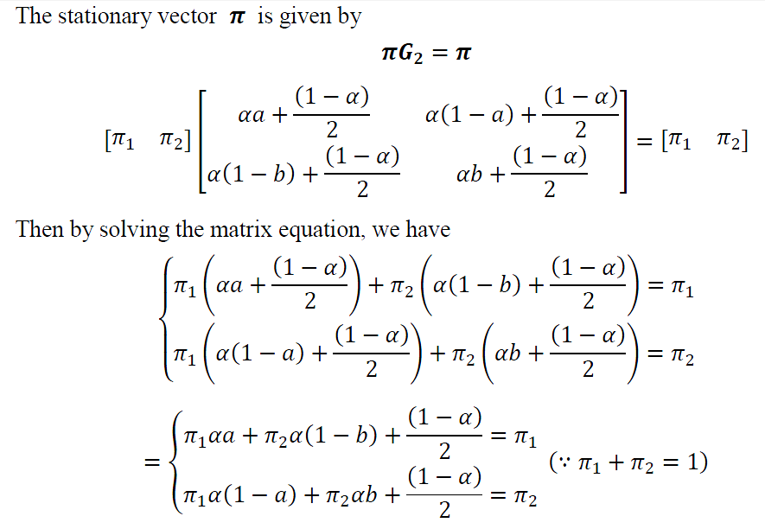
Proof

Slide 19
Proof (cont’d)
From the second equation, we have

Slide 20
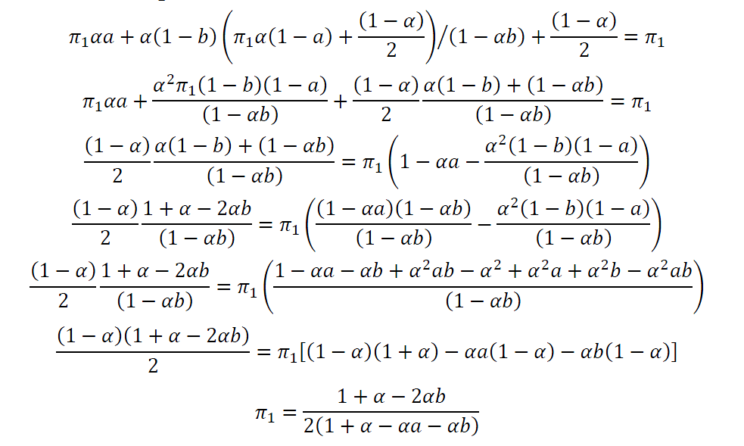
Proof (cont’d)

Slide 21
Proof (cont’d)

Slide 22
Proof (cont’d)
Hence we can say page 1 beat page 2 if and only if a>b

Slide 23
Low Dimension Case
Now consider a new page is added to this WWW

Slide 24
Low Dimension Case

Slide 25
Proposition 2
Proof:

Slide 26
Proposition 3
Proof

Slide 27
Proof (cont’d)

Slide 28
Proof (cont’d)

Slide 29
Proof (cont’d)

Slide 30
Proof (cont’d)

Slide 31
Proof (cont’d)

Slide 33
General Case
Consider there are n pages in WWW

Slide 34
General Case
Google Matrix G is given by

Slide 35
Property

Slide 36
Adding one new page
If we add one new page to the system:

Slide 37
Adding one new page

Slide 38
Adding one new page
Solving the equation, we have
In particular,

Slide 39
Comparison
Compare two situations:
Consider the changes of the first n pages:

Slide 40
Adding one new page

Slide 41
Adding k new pages
More generally,

Slide 42
Adding k new pages
And
The difference will turns to

Slide 43
Adding k new pages
We express it by matrix
And

Slide 44
Analysis

Slide 45
Direct Method and Indirect Method of voting

Slide 46
Direct Method and Indirect Method of voting

Slide 47
Direct Method and Indirect Method of voting

Slide 48
Consider the 2 by 2 case

Slide 49
Under Method A

Slide 50
Under Method A

Slide 51
Under Method A

Slide 52
Under Method B
Similar to method A

Slide 53
Under Method B

Slide 54
Under Method B
Compare with

Slide 55
Proposition 4
Proof:

Slide 56
Proof (cont’d)

Slide 57
Proof (cont’d)

Slide 58
Minimum of New Pages to Guarantee A Highest Rank Order

Slide 59
Minimum of New Pages to Guarantee A Highest Rank Order

Slide 60
Minimum of New Pages to Guarantee A Highest Rank Order

Slide 61
Minimum of New Pages to Guarantee A Highest Rank Order

Slide 62
Proposition 5
Proof:

