Slide 1
Stationary Probability Vector of a Higher-order Markov Chain
By Zhang Shixiao
Supervisors: Prof. Chi-Kwong Li and Dr. Jor-Ting Chan

Slide 2
Content
1. Introduction: Background
2. Higher-order Markov Chain
3. Conclusion

Slide 3
1. Introduction: Background
Matrices are widely used in both science and engineering.
In statistics
Stochastic process: flow direction of a particular system or process.
Stationary distribution: limiting behavior of a stochastic process.

Slide 4
Discrete Time-Homogeneous Markov Chains
A stochastic process with a discrete finite state space S
$$\begin{matrix}Pr\left(X_{t+1}=j|X_{t}=i,X_{t−1}=i_{t−1},X_{t−2}=i_{t−2},…,,X_{1}=i_{1},X_{0}=i_{0}\right) \\ =Pr\left(X_{t+1}=j|X_{t}=i\right)=p_{ij}\end{matrix}$$
A unit sum vector X is said to be a stationary probability distribution of a finite Markov Chain if PX=X where
$$P=\left(p_{ij},i,j∈S\right)$$

Slide 5
Discrete Time-Homogeneous Markov Chains
In other words
a coutinuous function f: $ℝ^{n}→ℝ^{n}$
which preserves at least one fixed point.

Slide 6
2. Higher-order Markov Chain
a stochastic process with a sequence of random variables, $\left\{X_{t},\left.t=0,1,2…\right\}\right.$, which takes on a finite set $S=\left\{\left.0,1,2,…,n\right\}\right.$ called the state set of the process
Definition 2.1 Suppose the probability independent of time satisfying
$$\begin{matrix}Pr\left(X_{t+1}=i|X_{t}=i_{1},X_{t−1}=i_{2},X_{t−2}=i_{3},…,,X_{1}=i_{t},X_{0}=i_{t+1}\right) \\ =Pr\left(X_{t+1}=i|X_{t}=i_{1},X_{t−1}=i_{2},X_{t−2}=i_{3},…,X_{t−m+1}=i_{m}\right) \\ =p_{i,i_{1},i_{2},⋯,i_{m}}\end{matrix}$$

Slide 7
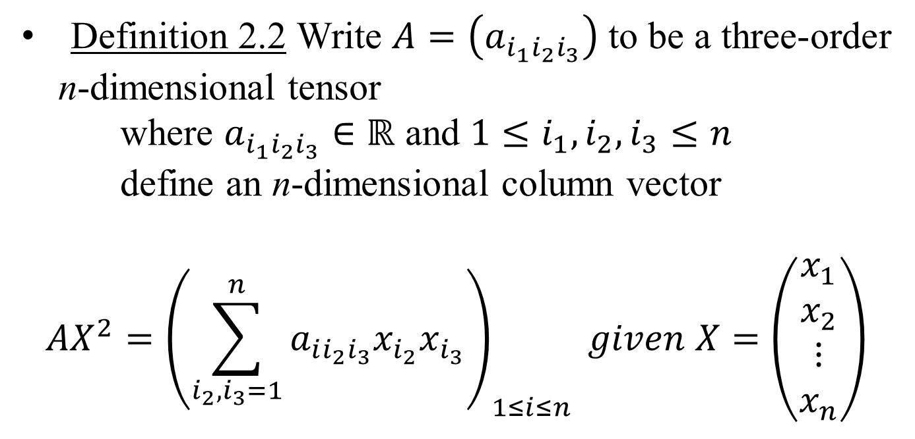
2. Higher-order Markov Chain
Definition 2.2 Write $Α=\left(a_{i_{1}i_{2}i_{3}}\right)$ to be a three-order n-dimensional tensor
where $a_{i_{1}i_{2}i_{3}}∈ℝ$ and $1≤i_{1},i_{2},i_{3}≤n$
define an n-dimensional column vector
$$ΑX^{2}={\left(\sum_{i_{2},i_{3}=1}^{n}{a_{ii_{2}i_{3}}x_{i_{2}}x_{i_{3}}}\right)}_{1≤i≤n} given X=\left(\begin{matrix}x_{1} \\ x_{2} \\ ⋮ \\ x_{n}\end{matrix}\right)$$

Slide 8
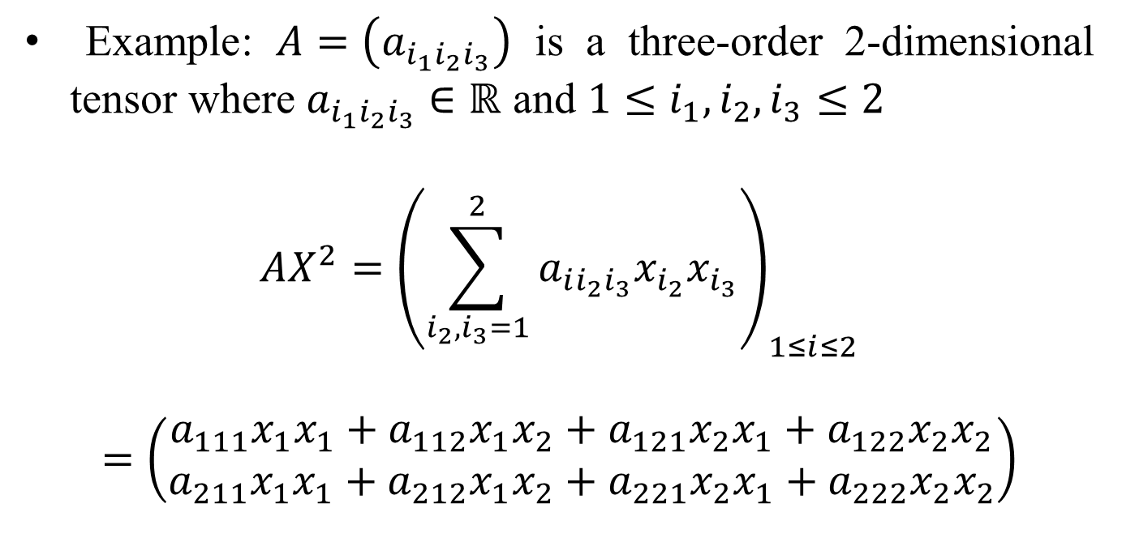
2. Higher-order Markov Chain
Example: $Α=\left(a_{i_{1}i_{2}i_{3}}\right)$ is a three-order 2-dimensional tensor where $a_{i_{1}i_{2}i_{3}}∈ℝ$ and $1≤i_{1},i_{2},i_{3}≤2$
$$ΑX^{2}={\left(\sum_{i_{2},i_{3}=1}^{2}{a_{ii_{2}i_{3}}x_{i_{2}}x_{i_{3}}}\right)}_{1≤i≤2}$$
$$=\left(\begin{matrix}a_{111}x_{1}x_{1}+a_{112}x_{1}x_{2}+a_{121}x_{2}x_{1}+a_{122}x_{2}x_{2} \\ a_{211}x_{1}x_{1}+a_{212}x_{1}x_{2}+a_{221}x_{2}x_{1}+a_{222}x_{2}x_{2}\end{matrix}\right)$$

Slide 9
Conditions for Infinitely Many Solutions over the Simplex
Theorem 2.1 Now we are considering
where all $a_{1},a_{2},b_{1},b_{2}∈\left[0,1\right],x∈\left[0,1\right]$
$$x\left(\begin{matrix}a_{1} & b_{1} \\ 1−a_{1} & 1−b_{1}\end{matrix}\right)\left(\begin{matrix}x \\ 1−x\end{matrix}\right)+\left(1−x\right)\left(\begin{matrix}a_{2} & b_{2} \\ 1−a_{2} & 1−b_{2}\end{matrix}\right)\left(\begin{matrix}x \\ 1−x\end{matrix}\right)=\left(\begin{matrix}x \\ 1−x\end{matrix}\right)$$

Slide 10
Conditions for Infinitely Many Solutions over the Simplex
Then one of the following holds
If $a_{1}=1,a_{2}+b_{1}＜1$, then we must have two solutions $x=1$ or $x=\frac{b_{2}}{b_{2}+1−a_{2}−b_{1}}$ to the above equation.
Otherwise, we must have a unique solution.
If $a_{1}=1,b_{2}=0,a_{2}+b_{1}=1$, then we must have infinitely many solutions, namely, every $\left(\begin{matrix}x \\ 1−x\end{matrix}\right)$ with $x∈\left[0,1\right]$ is a solution to the above equation.

Slide 11
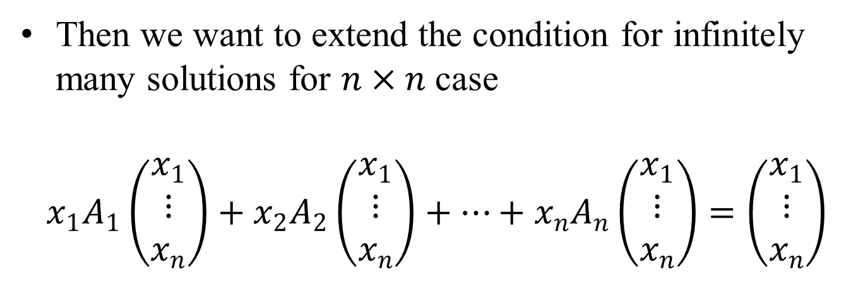
Conditions for Infinitely Many Solutions over the Simplex
Then we want to extend the condition for infinitely many solutions for $n×n$ case
$$x_{1}A_{1}\left(\begin{matrix}x_{1} \\ ⋮ \\ x_{n}\end{matrix}\right)+x_{2}A_{2}\left(\begin{matrix}x_{1} \\ ⋮ \\ x_{n}\end{matrix}\right)+⋯+x_{n}A_{n}\left(\begin{matrix}x_{1} \\ ⋮ \\ x_{n}\end{matrix}\right)=\left(\begin{matrix}x_{1} \\ ⋮ \\ x_{n}\end{matrix}\right)$$

Slide 12
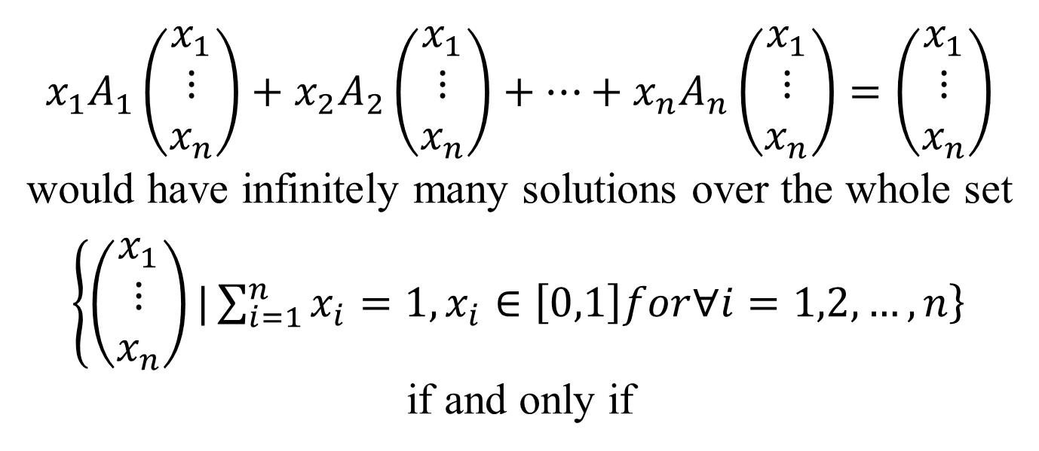
Main Theorem 2.2
$$x_{1}A_{1}\left(\begin{matrix}x_{1} \\ ⋮ \\ x_{n}\end{matrix}\right)+x_{2}A_{2}\left(\begin{matrix}x_{1} \\ ⋮ \\ x_{n}\end{matrix}\right)+⋯+x_{n}A_{n}\left(\begin{matrix}x_{1} \\ ⋮ \\ x_{n}\end{matrix}\right)=\left(\begin{matrix}x_{1} \\ ⋮ \\ x_{n}\end{matrix}\right)$$
would have infinitely many solutions over the whole set
$\left\{\left(\begin{matrix}x_{1} \\ ⋮ \\ x_{n}\end{matrix}\right)\right.\left.|\sum_{i=1}^{n}{x_{i}}=1,x_{i}∈\left[0,1\right]for∀i=1,2,…,n\right\}$
if and only if

Slide 13
Main Theorem 2.2

Slide 14
Main Theorem 2.2

Slide 15
Main Theorem 2.2

Slide 16
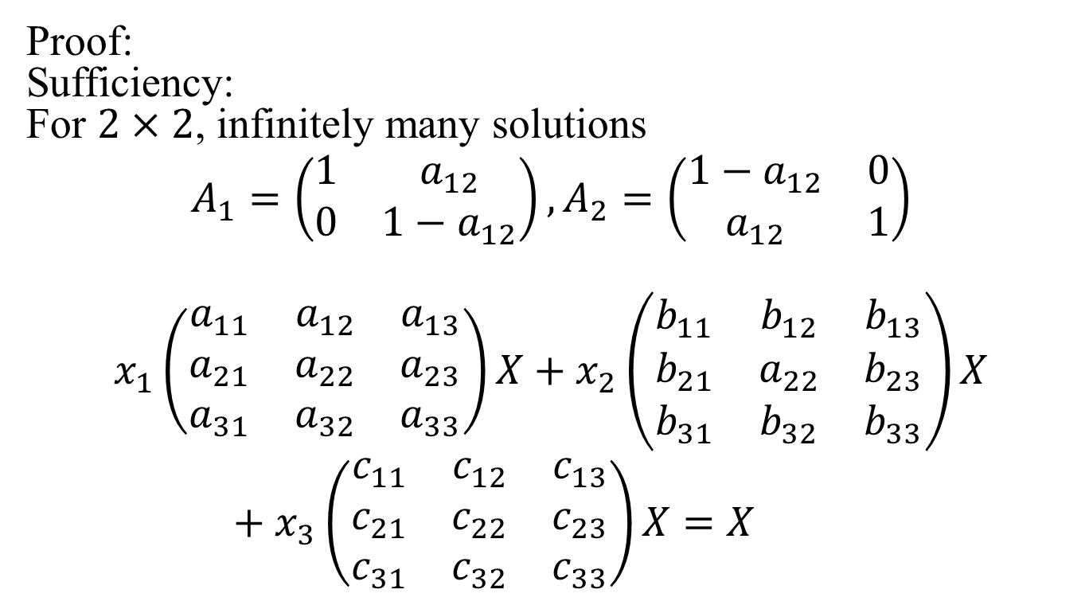
Main Theorem 2.2
Proof:
Sufficiency:
For $2×2$, infinitely many solutions
$$A_{1}=\left(\begin{matrix}1 & a_{12} \\ 0 & 1−a_{12}\end{matrix}\right),A_{2}=\left(\begin{matrix}1−a_{12} & 0 \\ a_{12} & 1\end{matrix}\right)$$
$$x_{1}\left(\begin{matrix}a_{11} & a_{12} & a_{13} \\ a_{21} & a_{22} & a_{23} \\ a_{31} & a_{32} & a_{33}\end{matrix}\right)X+x_{2}\left(\begin{matrix}b_{11} & b_{12} & b_{13} \\ b_{21} & a_{22} & b_{23} \\ b_{31} & b_{32} & b_{33}\end{matrix}\right)X+x_{3}\left(\begin{matrix}c_{11} & c_{12} & c_{13} \\ c_{21} & c_{22} & c_{23} \\ c_{31} & c_{32} & c_{33}\end{matrix}\right)X=X$$

Slide 17
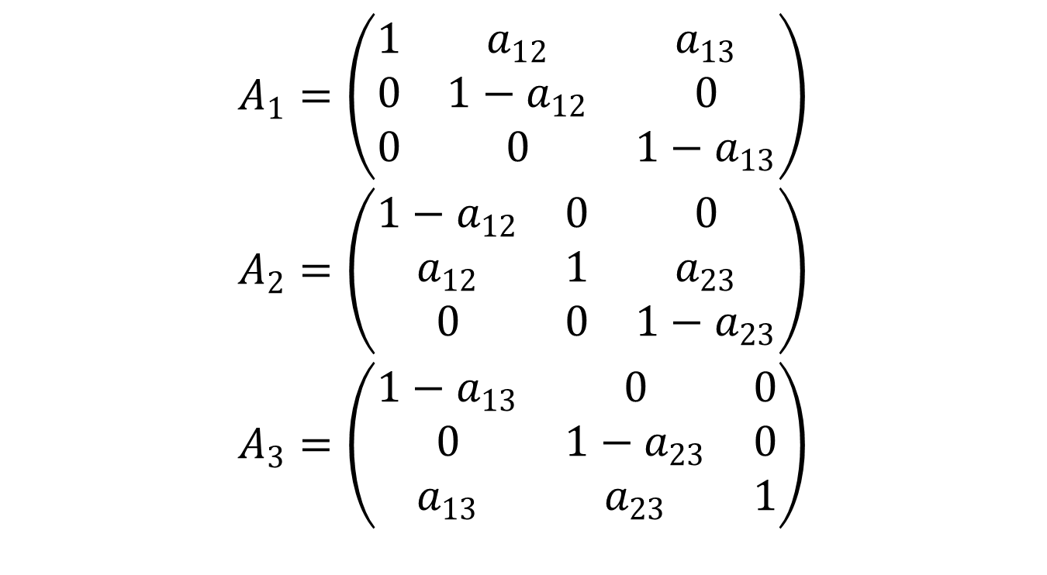
Main Theorem 2.2
$$A_{1}=\left(\begin{matrix}1 & a_{12} & a_{13} \\ 0 & 1−a_{12} & 0 \\ 0 & 0 & 1−a_{13}\end{matrix}\right)$$
$$A_{2}=\left(\begin{matrix}1−a_{12} & 0 & 0 \\ a_{12} & 1 & a_{23} \\ 0 & 0 & 1−a_{23}\end{matrix}\right)$$
$$A_{3}=\left(\begin{matrix}1−a_{13} & 0 & 0 \\ 0 & 1−a_{23} & 0 \\ a_{13} & a_{23} & 1\end{matrix}\right)$$

Slide 18
Main Theorem 2.2

Slide 19
Main Theorem 2.2

Slide 20
Other
Given any two solutions lying on the interior of
1-dimensional face of the boundary of the simplex, then the whole 1-dimensional face must be a set of collection of solutions to the above equation.
Conjecture: given any k+1 solutions lying in the interior of the k-dimensional face of the simplex, then any point lying in the whole k-dimensional face, including the vertexes and boundaries, will be a solution to the equation.

Slide 21
3. Conclusion

Slide 22
Thank you!

