Slide 1
Use of Bayesian Inference in Linguistic studies
Stephany Palmer
10/27/2020
Notes:
I will be continuing last class’ talks on statistics with my own, but thankfully on a topic not already covered, Bayesian inference, and its usage in linguistic studies, though the Bayesian method is universally applicable to studies of other topics.

Slide 2
Data/ Information analysis
You collect data, what can you do with it?
Descriptive Statistics: summarize your sample
Mean
Variance
Standard Deviation, etc.
Inferential Statistics: find out something about the population, not just your sample

Slide 3
Frequentist vs Bayesian
Frequentist Probability
Bayesian Probability
Classical method
Unknown can only be estimated
Can’t say “actual probability is equal to …”
Data is real, some results are more plausible than others
Use of prior knowledge
Can say “there is a 95% probability…”

Slide 4
“A frequentist is a person whose long-run ambition is to be wrong 5% of the time.” “A Bayesian is one who, vaguely expecting a horse, and catching a glimpse of a donkey, strongly believes he has seen a mule.”

Slide 5
Frequentists vs Bayesians
Karl Pearson
Ronald Fisher
Jerzy Neyman
Thomas Bayes
Pierre-Simon Laplace

Slide 6
An example
$$\overline{x}=55\%,$$
95%$confidence interval=$
[44.72%, 64.96%].

Slide 7
An example

Slide 8
Bayes’ Theorem
$$P\left(\left.A\right|B\right)=\frac{P\left(\left.B\right|A\right)P\left(A\right)}{P\left(B\right)}$$

Slide 9
Bayesian Inference
Prior x Likelihood $∝$ Bayesian Result
Probability of our data, P(B), is ignored.

Slide 10
Prior
The prior summarizes our knowledge before collecting data.
This probability distribution can be based on previous studies and should be justified.
Can be either vague/uninformative or highly informative, depending on how much is known.
$$P\left(\left.A\right|B\right)=\frac{P\left(\left.B\right|A\right)P\left(A\right)}{P\left(B\right)}$$

Slide 11
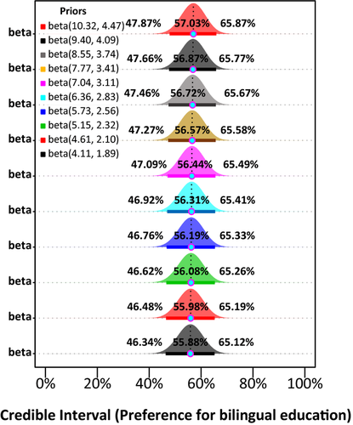
Choice of Priors
Choose carefully.
1) Obtain a set of priors with different levels of representativeness for past research findings
2) Obtain a Bayesian result using each prior
3) Compare their credible intervals
If big differences, priors aren’t robust/useful

Slide 12
Likelihood
$$P\left(\left.A\right|B\right)=\frac{P\left(\left.B\right|A\right)P\left(A\right)}{P\left(B\right)}$$
The foundation of most frequentist techniques.
Given our prior, how likely is it that we got our data?
If our prior and our data are very different, we will get a low likelihood.
Low likelihood-> prior is informative. Less informative the better.

Slide 13
Posterior
$$P\left(\left.A\right|B\right)=\frac{P\left(\left.B\right|A\right)P\left(A\right)}{P\left(B\right)}$$
Given our data, how likely is it that our prior beliefs accurately represent the data?
The posterior distribution contains the information needed for statistical inference and summarizes our knowledge of the parameters of interest based on:
What we assumed at the beginning of the study, and
What we have learned about our parameters after observing all the data.

Slide 14
Credible Interval
The Bayesian equivalent of frequentist confidence intervals but can use stronger language in their interpretation due to the Bayesian definition of probabilities.
95% frequentist confidence interval for the difference in two group means might be (–1.25, –0.55).
The frequentist interpretation: “confidence intervals constructed in this way can be expected to contain the true mean difference in 95% of studies.”
If we obtained the same values from a Bayesian credible interval, interpret them as: “given the prior and model, we believe that the true mean difference lies between –1.25 and –0.55 with 95% probability.”

Slide 15
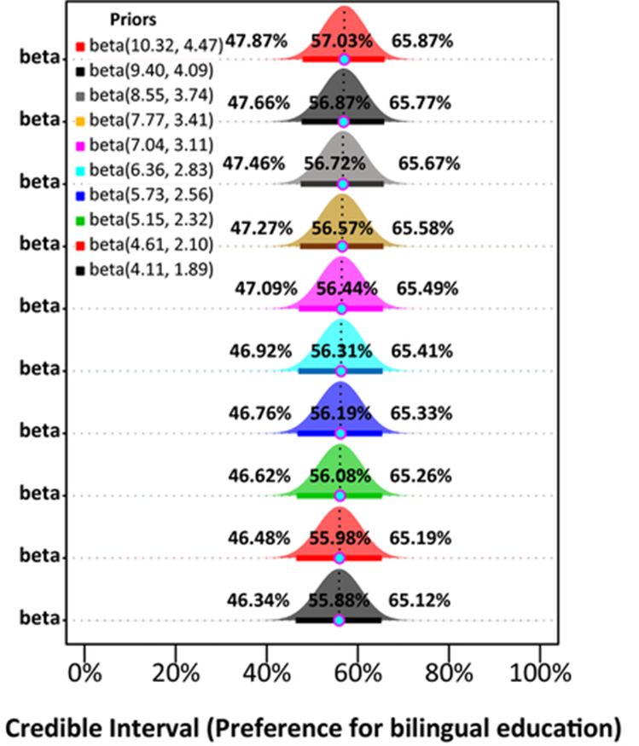
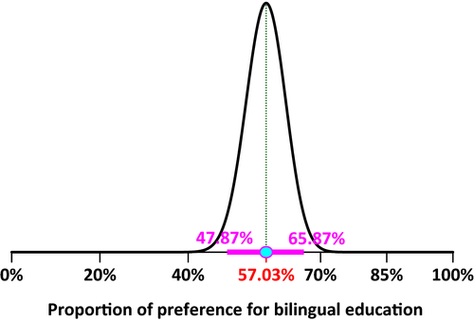
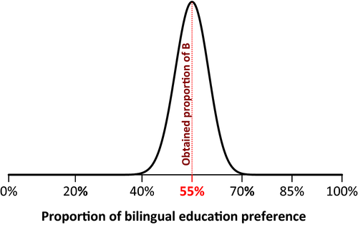
Example continued
$$×$$
$$∝$$

Slide 16
Advantages
Intuitive
Easier to model now
Don’t have to worry about the population parameters

Slide 17
Disadvantages
Priors are subjective
Computationally intensive
Not as common-> used less in studies

Slide 18
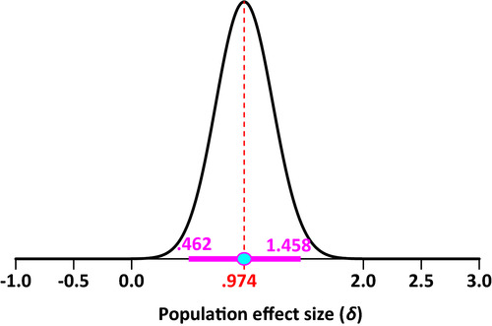
Another Example
Investigated the effect of the interaction mode (i.e., computer‐mediated communication vs. face‐to‐face interaction) when they provided 24 intermediate‐level learners of Spanish with opportunities to modify their output during interactional feedback episodes with their teacher.
After collecting their data, the authors conducted a paired‐samples t test to answer their research question, finding t(23) = 5.03, with descriptive results favoring the face‐to‐face environment.

Slide 19
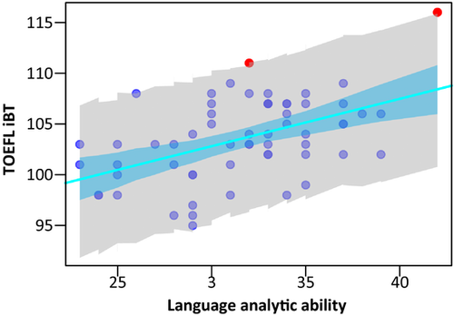
Bayesian Regression
Setup the model the same way.
Set unknown parameters to prior.
Can language proficiency be predicted by language analytic ability.

Slide 20
References
Oleson, J. J., Brown, G. D., & McCreery, R. (2019). The evolution of statistical methods in speech, language, and hearing sciences. Journal of Speech, Language and Hearing Research (Online), 62(3), 498-506. doi:http://dx.doi.org.proxy.wm.edu/10.m44/2018_JSLHR-H-ASTM-18-0378
Hsu, Anne S., et al. “The Probabilistic Analysis of Language Acquisition: Theoretical, Computational, and Experimental Analysis.” Cognition, vol. 120, no. 3, 26 Mar. 2011, pp. 380–390. ScienceDirect, doi:https://doi.org/10.1016/j.cognition.2011.02.013.
Norouzian, R., de Miranda, M. and Plonsky, L. (2018), The Bayesian Revolution in Second Language Research: An Applied Approach. Language Learning, 68: 1032-1075. doi:10.1111/lang.12310
Cthaeh, The, et al. “Frequentist and Bayesian Approaches in Statistics.” Probabilistic World, 19 Apr. 2020, www.probabilisticworld.com/frequentist-bayesian-approaches-inferential-statistics/.

