Slide 1
Quantum Algorithms in Data Fitting
By Brian Lorn

Slide 2
Data Fitting
Establish the relationship between the data points
More commonly, description of how a series of independent variables contributing to a dependent variable
Applications in many disciplines such as business, medical studies, scientific experiments, and many more
Real observations must be written in a mathematical form
Data can either be quantitative or qualitative

Slide 3
Types of Data Fitting
Interpolation: estimating relation between known data points
Estimations and predictions are limited to range of data points
Extrapolation: estimating relation outside of known data points
Estimations and predictions are not limited to range of data points
Higher risk of uncertainty or false relationship
Smoothing: creating a function that captures the most significant patterns in the data while leaving out outliers from the data
Acts on the data points themselves without relying on explicit function
Best at demonstrating general patterns rather than precise inferences

Slide 4
Methods of Data Fitting
Interpolation and Extrapolation:
Linear models, higher order models, interactive models, quantitative models, multiplicative models, and nested models
Multivariate scale increases the complexity of the model but generally increase its accuracy as well
Found through classical algorithms run through programs like R, MATLAB, and Wolfram Mathematica
Smoothing:
Adjacent data points are increased while individual data points that are higher or lower are reduced
Linear smoothers are operations performed by a hat matrix in a process known as convolution
Found through algorithms such as exponential smoothing or moving average

Slide 5
Implementation of Data Fitting
Interpolation and Extrapolation:
Statistical tests to find model adequacy
Specific hypothesis testing on certain coefficients or individual variables
Estimate or predict values
Find the strength of the relationships between data
Smoothing:
Smoothed data set can be further analyzed for general patterns and other nuances
Degree of error increases as data set is being modified before being analyzed

Slide 6
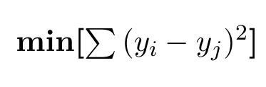

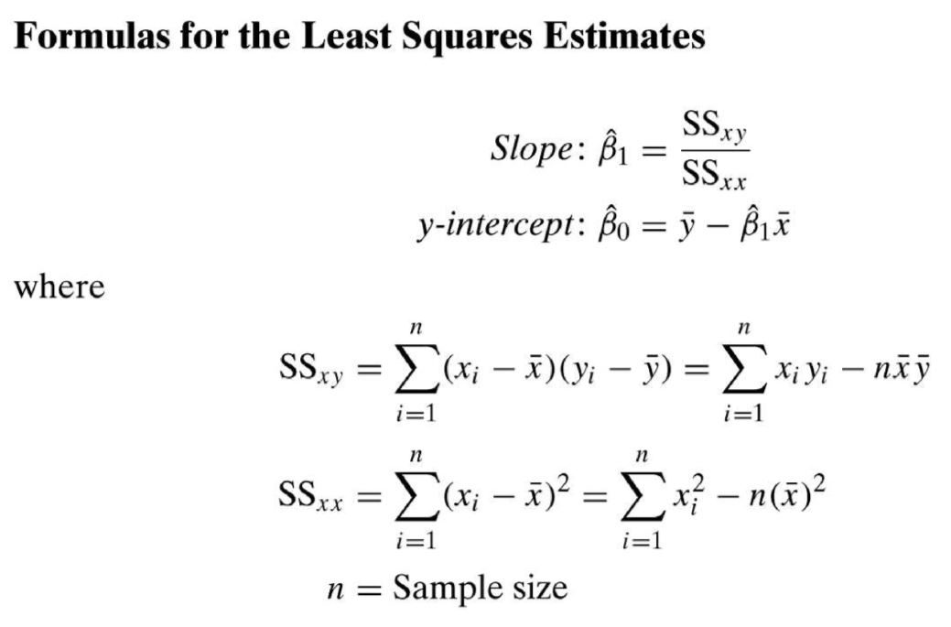
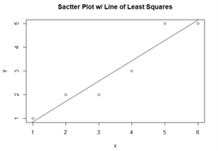
Method of Least Squares
One of the most common techniques to fit data for interpolation or extrapolation
Creates a best fit for the data that minimizes the sum of squared residuals in mathematical notation:
In simple linear regression, the deterministic model is with
Limited in only accounting for observational errors on the dependent variable
Can be applied to linear, nonlinear, and higher order models
Classical algorithms either use QR factorization or iteration to create a model

Slide 7
Method of Total Least Squares (TLS)
Accounts for observational errors in both the dependent and independent variable
Generalization of Deming regression (orthogonal regression)
Can be applied to linear, non-linear, and higher order models
In the method, the objective function is
where r_{x} and r_{y} are vectors of residuals while M_{x} and M_{y} are covariance matrices
To form the model, this objective function is minimized which results in
where X is the matrix of constants or functions of x and β is the relationship between x and y

Slide 8
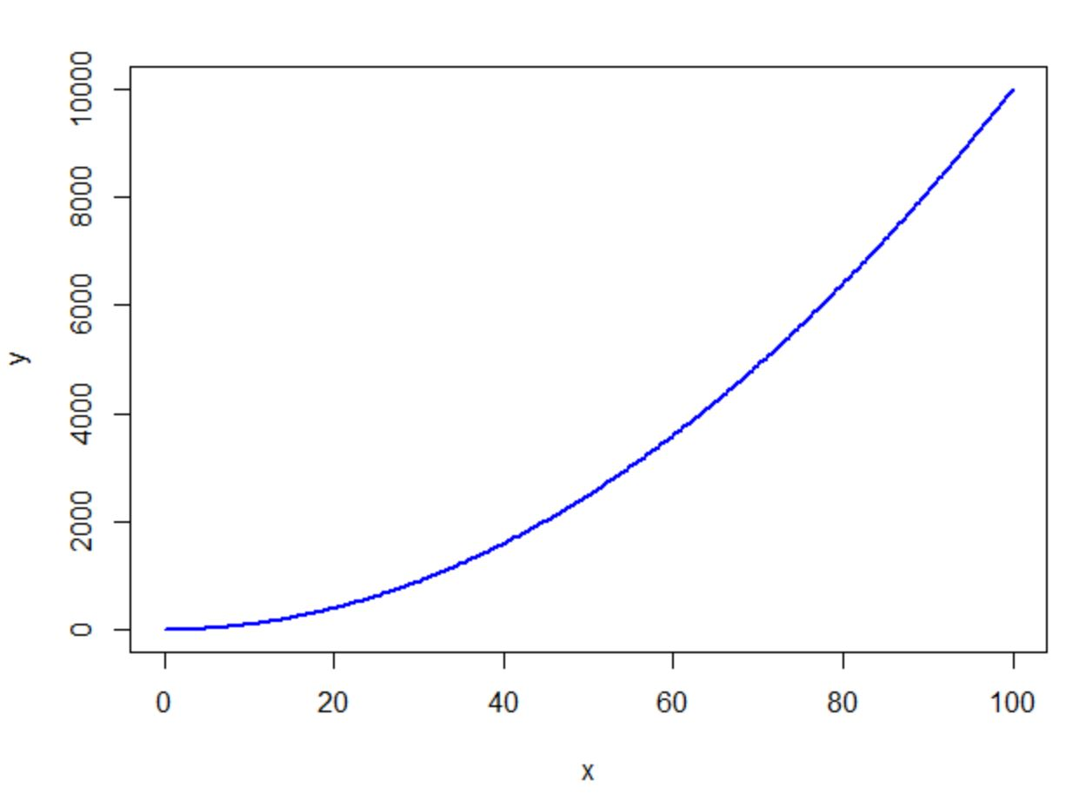
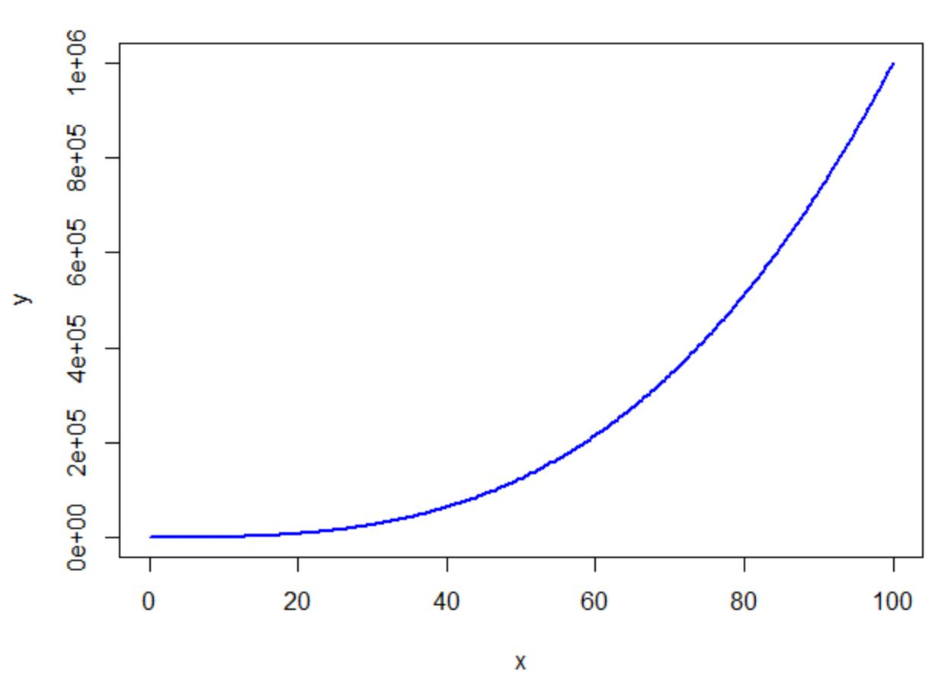
Classical Implementation of Method of Total Least Squares
Note that SVD can be used to minimize the objective function
Classical algorithms depend on the SVD for computation making the run time 26N³ where N is the number of data
For the partial SVD calculated through the s-step Lanczos procedure, O(N²)
Difficult for classical computers to model large amounts of data

Slide 9


Quantum implementation of the Method of Total Least Squares
TLS problem can be simplified to finding the vector v_{n+1} which corresponds to the smallest singular value in the matrix C
Obtained by solving for the eigenvectors of where C = [A, y]
For simplicity, the quantum algorithm examines D = diag(C*C, . . ., C*C)
Thus, the TLS problem is solved by finding the ground state of D

Slide 10
Quantum implementation of the Method of Total Least Squares (continued)
Transition frequency between 2 energy levels of the system matches the frequency of a probe qubit
Varying the frequency of the probe qubit allows the energy spectrum of the system to be determined
It can then be changed to any eigenstate for any eigenvalue
This can be used to compute the eigenvalues and eigenvectors matrix shown on the last slide

Slide 11
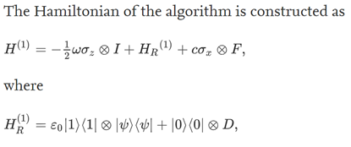
Quantum Algorithm
and I is the identity operator, σ_{x} and σ_{z}are the Pauli matrices, and ω is the frequency of the probe qubit
H_{R} refers to the encoded D matrix
Third term is the pairing of the probe qubit and the n-qubit register of the system
F transforms the reference state psi to the desired eigenstate of D

Slide 12

Quantum Algorithm continued
In order to find the ground state of v_{n+1}, the eigenvalue must be found
The eigenvalue can be obtained by quantum simulation of resonant transitions
First set range for ground eigenvalue then scan these frequency points for the probe qubit
Circuit is initially set to so
Then transition frequency of probe qubit is set then implement
Measure probe qubit in its computational basis
Repeat for all frequencies to obtain the ground state eigenvalue of the matrix D
Encode this value in the Hamiltonian by setting
After running the algorithm again, the probe qubit should decay to 0 kat, meaning the n-qubit register collapses to the ground state
Therefore, the system evolves from its initial state to

Slide 13

Analysis of the Quantum Algorithm
Limited by having an initial guess of the ground state D (approximate using the LS method)
The runtime of the algorithm is a combination of the number of experiments that must be run to find the eigenvalue and the time needed to run each circuit
The latter depends on computation cost for running the algorithm on a quantum computer
Overall, the algorithm has w where k = condition number and ϵ is the precision of the guess
Thus, the algorithm results in polynomial speedup

Slide 14
Conclusion
Quantum algorithms can result in much faster computation of data fits
Useful in analyzing large amounts of data that would be difficult to do with a classical algorithm
Limited by the availability and complexity of Quantum computation

