Slide 1
Differential Equations and its applications
David Liu

Slide 2
Ordinary Differential Equations
Differential Equations are equations containing derivatives.

Slide 3
Example (Logistic Population Model)
Assumptions:
the reproduction rate is proportional to the size of the population when the population size is small
the growth is negative when the size is large

Slide 4
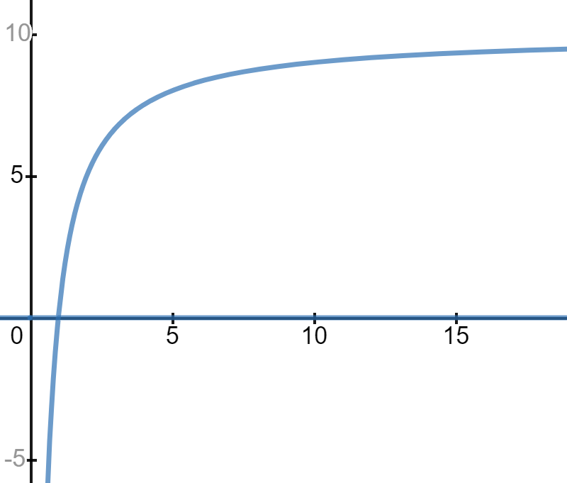
Variables: P, t
Parameters: k, N
Equilibrium: 0, N

Slide 5
Separation of Variables
P0 is the initial population
N= 10, k = 1

Slide 6
Example (The Classic Predator-Prey Model)
Fox eat rabbit
With more foxes and more rabbits, more rabbits die
With more foxes and more rabbits, more foxes are born
Rabbit birth rate not related to fox in this model
Fox death rate not related to rabbit in this model

Slide 7
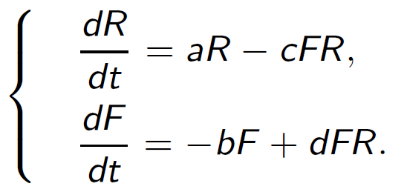
Differential equations representing a system
Three variables, R-rabbit, F-fox, t-time
a – birth rate of rabbits
b – death rate of fox
c – death rate of rabbits, interrelated with both rabbit and fox
d – birth rate of fox

Slide 8
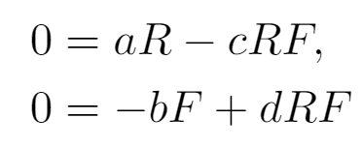
Equalibrium Solution
When R = 0,
When F = 0,

Slide 9
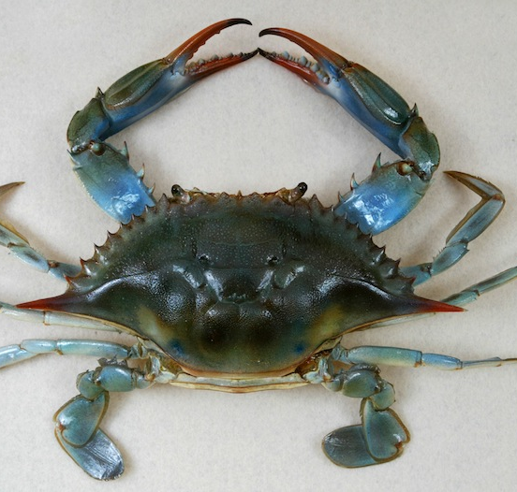
Population model for blue crabs and the parasitic disease, Hematodinium
Cannibalism ( adult on juvenile)
Fishing
Predation( on juvenile)
One of the parasitic diseases----
Hematodinium perezi

Slide 10
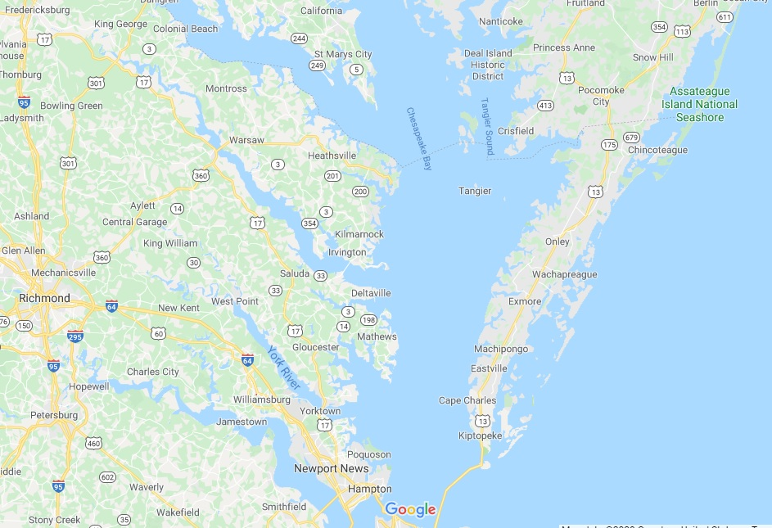
Chesapeake Bay
Lagoon

Slide 11
Hematodinium perezi
an internal dinoflagellate parasite that infects crustaceans, including blue crabs
Since it is a parasite, when modeling, a separate term is required for the parasite in free water, denoted as H

Slide 12
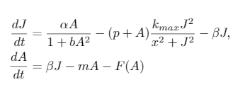
Population model without the disease from Fangming Xu
Juvenile Crabs = Recruitment( from reproduction) - (Cannibalism + Predation)
- Maturation
Adult Crabs = Maturation - other mortality - Fishing

Slide 13
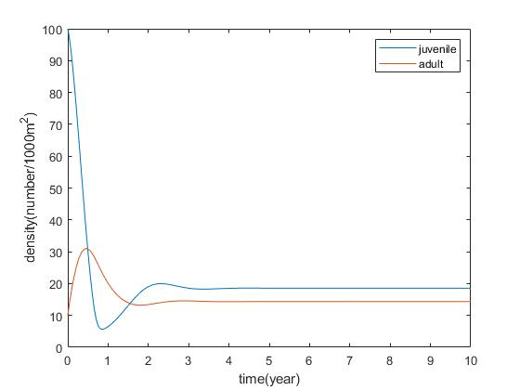
X = 5
J0 = 100
A0 = 10

Slide 14
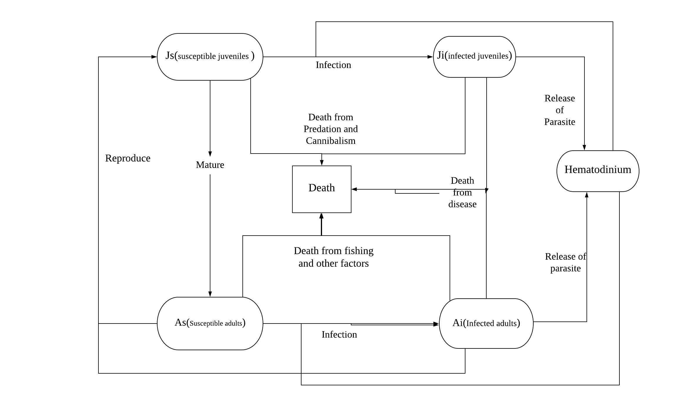
Relationship between crab population and other factors

Slide 15
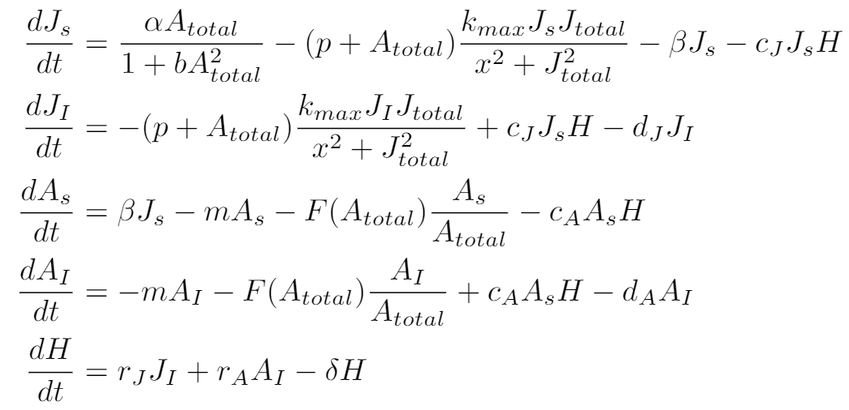

Slide 16
More applications

Slide 17
Question
What would happen if we relate the death rate of foxes to the number of rabbits and the birth rate of rabbits to the number of foxes? Or is it not necessary at all?

Slide 18
References
Stage-structured Blue Crab Population Model with Fishing, Predation andCannibalism
By Fangming Xu, 2020
Class notes from Dr. Mengying Xiao

