Slide 1
Mathematics in infectious diseases and epidemiology
Submitted by: Mohamed Mostafa

Slide 2
Introduction
Mathematical models are very important with regards to infectious diseases to gauge how they are progressing and whether they may turn into an epidemic.
This is what further informs public health policy and necessary interventions that need to take place.
Assumptions and statistics are used to calculate the impact of interventions and the progression of diseases.
Modelling enables experts to decide which policies must be put in place, which measures should be taken and how the disease will progress all over the world.

Slide 3
History
It has been used throughout the ages to gauge how diseases spread, in order to control outbreaks.
Following that, the law of mass action was applied to elaborate on how epidemics work.
The 20th century saw the use of compartmental models in order to predict how epidemics would come about.
The first theory to come up was about the inoculation of smallpox, aiming to increase the life expectancy.
Agent based models are now being used, even during COVID-19.

Slide 4
Assumptions
Assumptions are imperative with regards to the models and their accuracy.
A major assumption made is regarding age distribution and this works well mostly for developed countries.
In terms of mixing, homogenous mixing is assumed in order to make the calculations simpler but this is not always the case.

Slide 5
How to formulate epidemiology models
The horizontal incidence is the infection rate of susceptible indidividuals in accordance with contact with people who are infected.
If a function of S is the number of susceptibles, the function of I is the number of infectives and N is the total population size.
Simple mass action law nIS = n(Ni)(Ns) is used for horizontal incidence, while standard incidence is better for animal samples sizes.

Slide 6

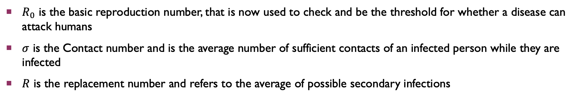
Relevant quantities
$R_{0}$ , $σ$ and $R$
$R_{0}$ is the basic reproduction number, that is now used to check and be the threshold for whether a disease can attack humans
$σ$ is the Contact number and is the average number of sufficient contacts of an infected person while they are infected
$R$ is the replacement number and refers to the average of possible secondary infections

Slide 7
Types of epidemiology Models
The Classic Epidemic Model
The Classic Endemic Model

Slide 8
The MSEIR Model
While the classic models assume the population size to be constant, that is actually not the case and that is where the MSEIR model comes in.
M is the passively immune class, S is the susceptible class, E is the exposed class, I is the infective class and R is the recovered class.

Slide 9
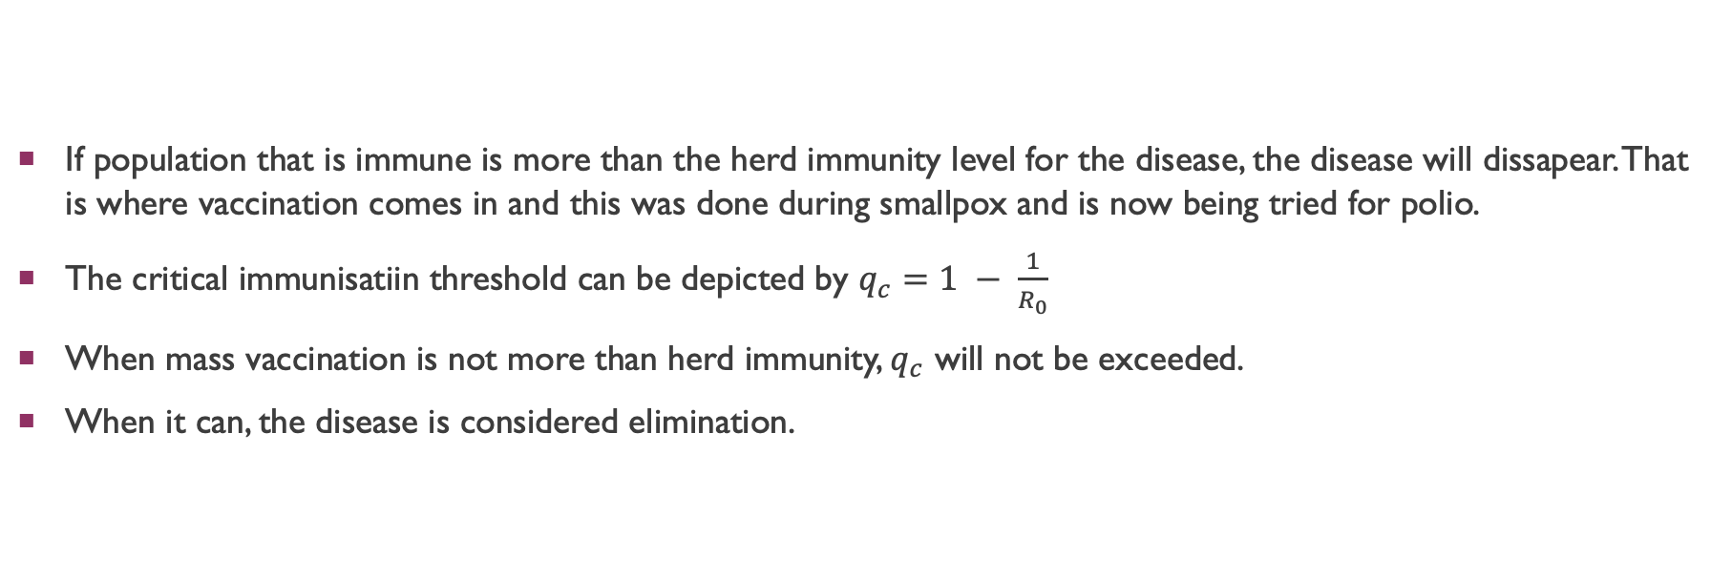
Mathematics for mass vaccination
If population that is immune is more than the herd immunity level for the disease, the disease will dissapear. That is where vaccination comes in and this was done during smallpox and is now being tried for polio.
The critical immunisatiin threshold can be depicted by $q_{c}=1 − \frac{1}{R_{0}}$
When mass vaccination is not more than herd immunity, $q_{c}$ will not be exceeded.
When it can, the disease is considered elimination.

Slide 10
References
Hethcote HW (2000). "The mathematics of infectious diseases". Society for Industrial and Applied Mathematics. 42: 599–653.
R. M. ANDERSON, E,D., Population Dynamics of Infectious Diseases, Chapman and Hall, London, 1982.
Brauer F, Castillo-Chávez C (2001). Mathematical Models in Population Biology and Epidemiology. New York: Springer.

