Slide 1
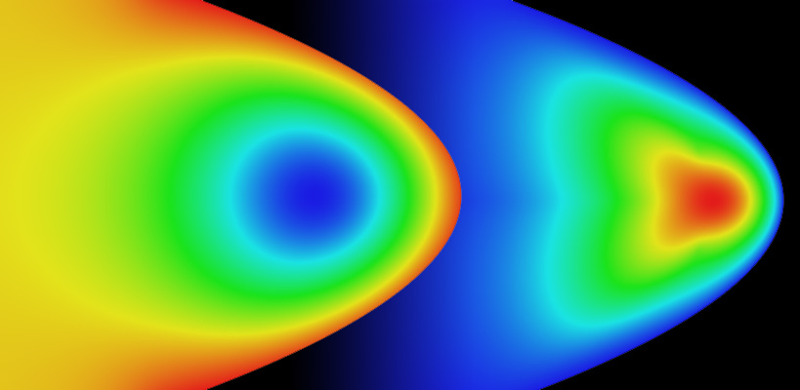
Finite Element Analysis
Annette Lopez Davila

Slide 2
How do we know which areas of the car are most likely to be broken when force is applied?
Notes:
When we look at an object, we look at its shape, its components, and how it responds to the environment. Let’s look at this car. We all know that if we go up to the windshield and kick it, there is a good chance it will break. We also know that if we go up to the front of the car and kick it, we probably wont break it; there’s a greater chance that you hurt your foot or dented the metal slightly.
Why is this? What do we know about the car that makes us come up with these conclusions. One of the most obvious reasons is because we know that glass is rather easy to shatter, and metal will just bend.

Slide 3
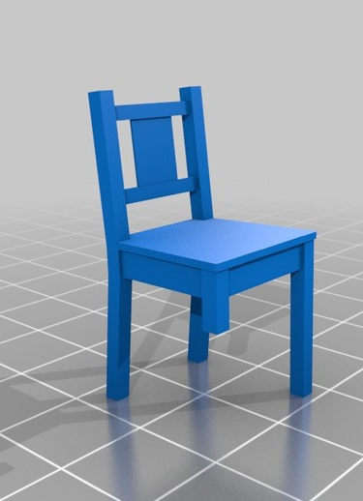
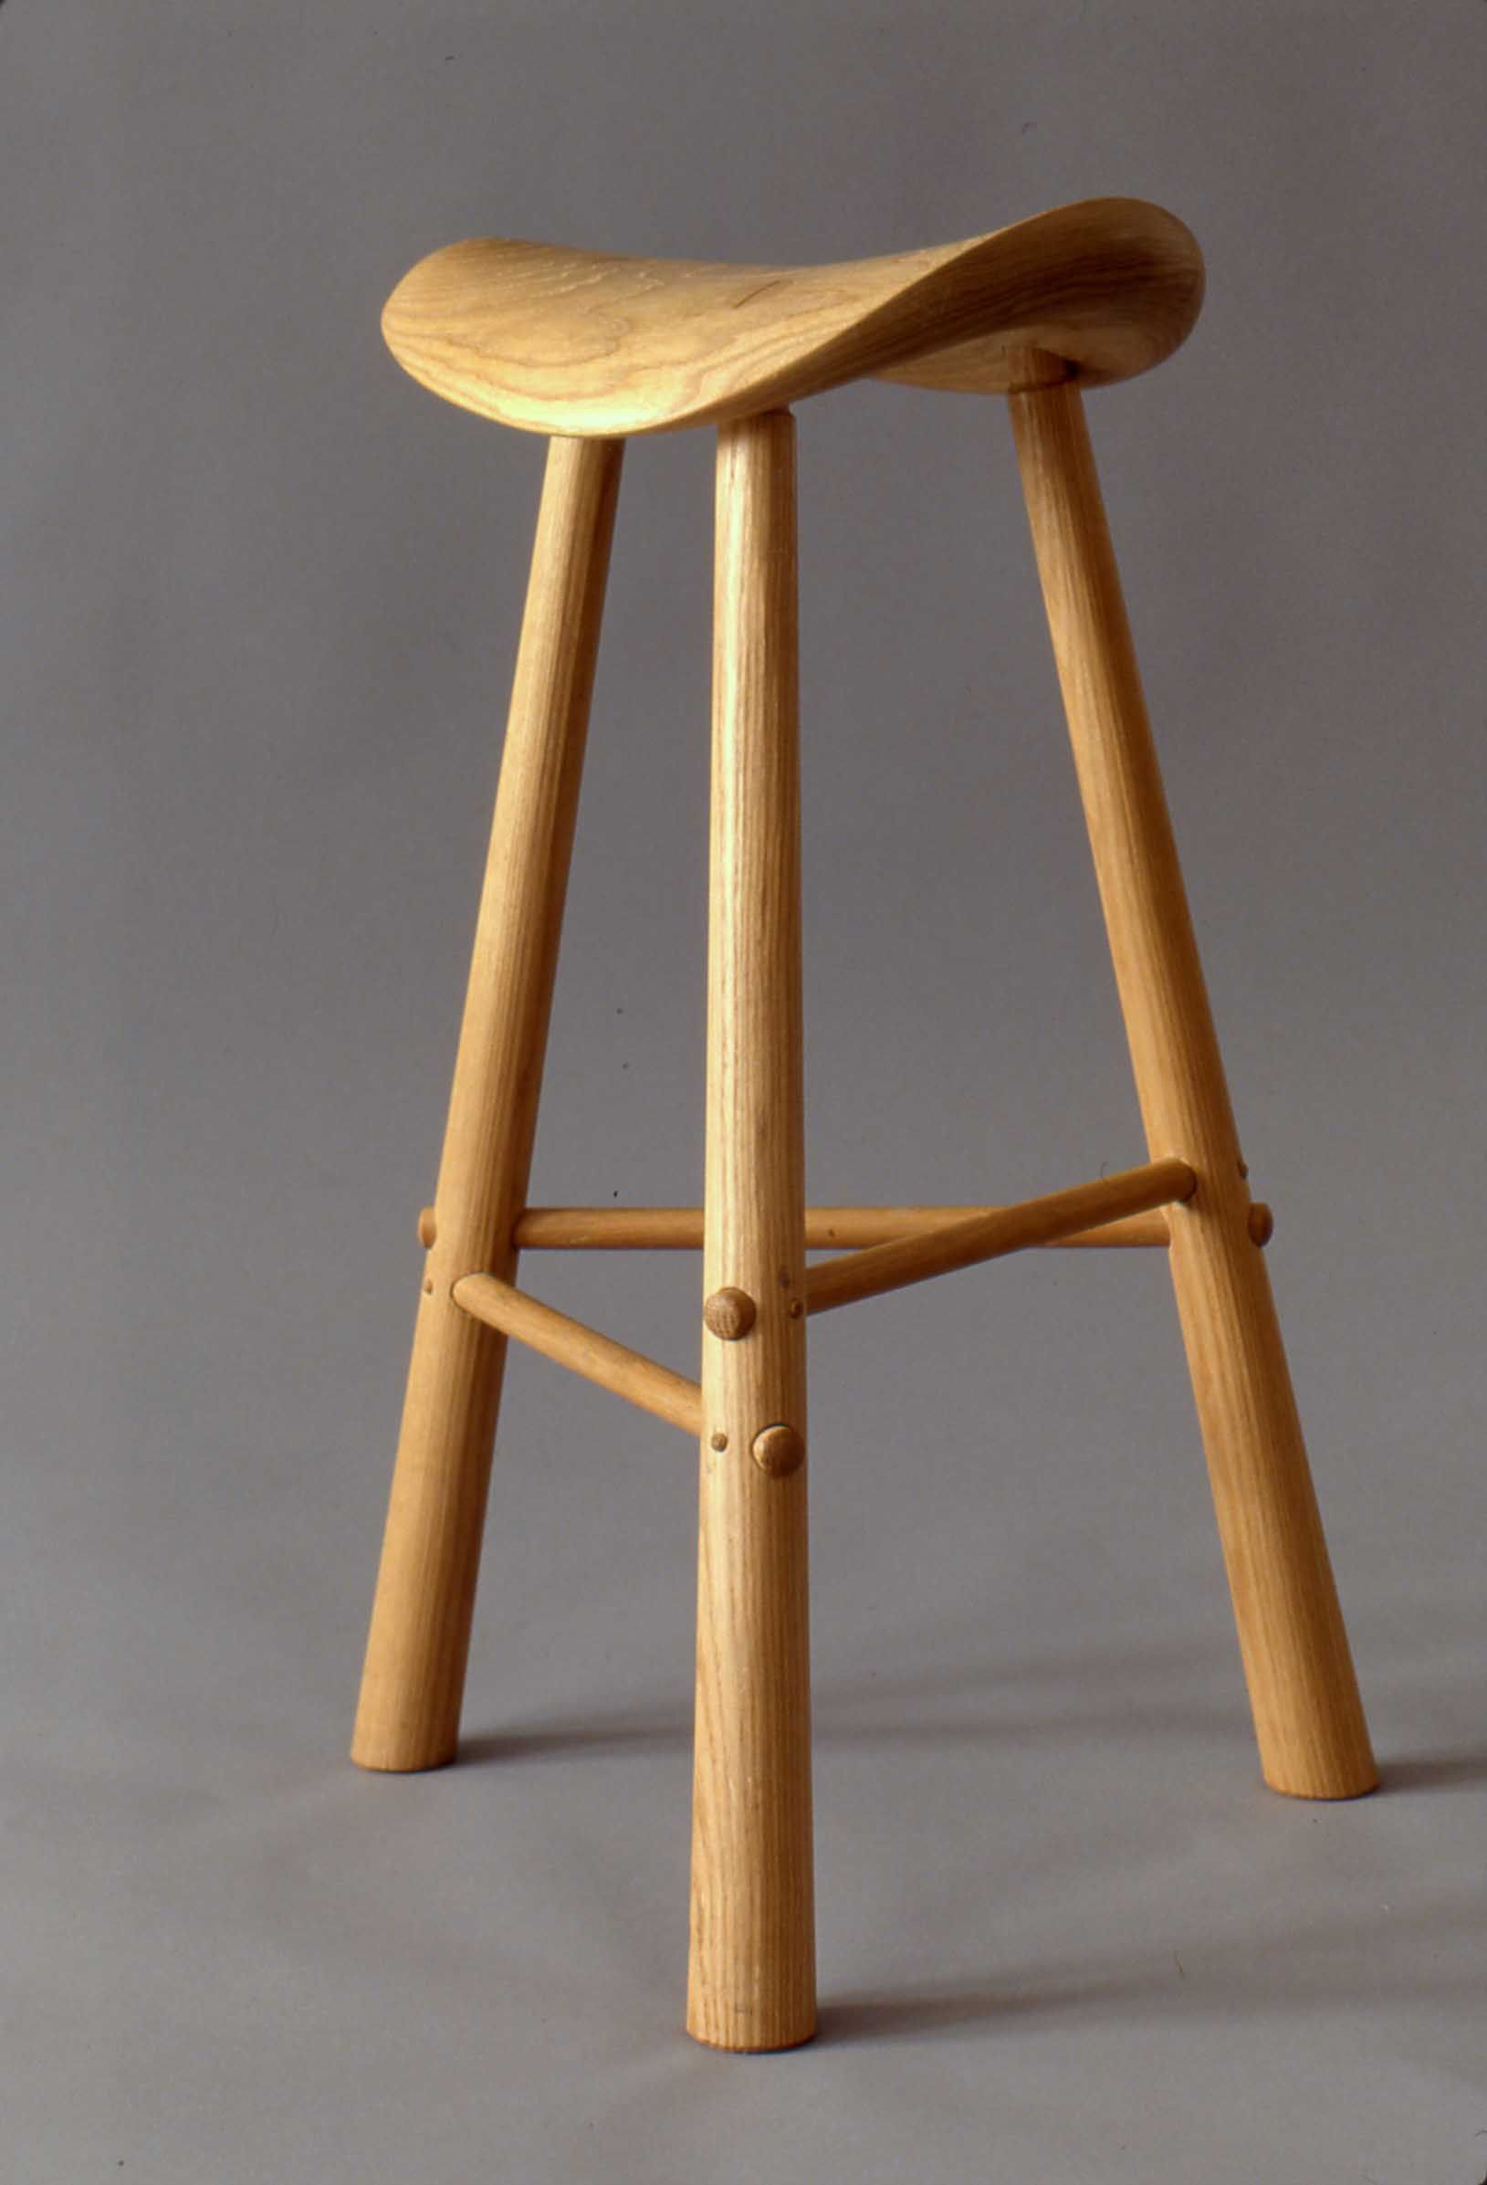
Which chair is more likely to fall?
Notes:
Lets look at these chairs. Assume both are made from the same wood. Which chair is more likely to fall?
Our intuition tells us that the blue chair simply cannot work, but the light brown chair could. Both have three legs and are made of the same material, so what’s different.
The structure of these objects tells us whether or not they can withstand gravity or some other force placed on it.

Slide 4
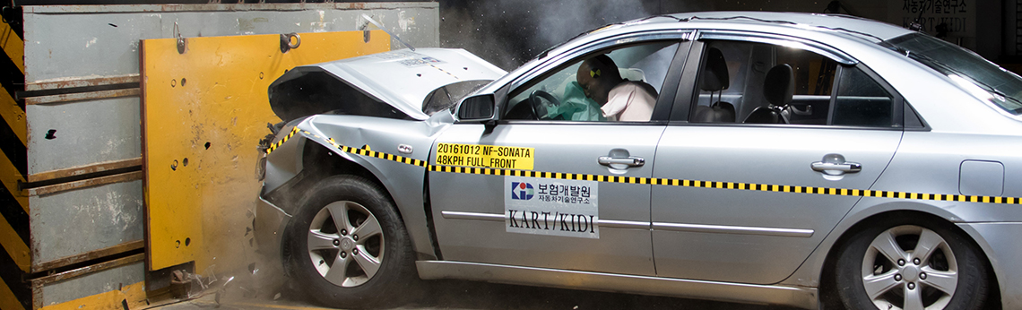
Testing Objects
The car is one object composed of many other objects such as wheels, windows, doors, a motor, etc.
Each object must work in sync with the other objects for optimal functionality
Car crash tests are conducted for determination of strength of a car when confronted by some force.
Why not simulate it instead?
Notes:
Going back to the car example, we know that the car is one object composed of many other objects such as wheels, windows, doors, a motor, etc.
Each element has to be at some sort of equilibrium with the rest in order for the object to function the way we want it to. When one element is out of balance, the others also change.
Before we had computers, we could only use physics and tests to tell us about the function of an object and how it interacts in the world. For example, car crash tests are conducted to tell us about the strength of a car when confronted by some force. Nowadays, we don’t have to spend all that money and energy testing cars; we can just simulate the experience and model it.

Slide 5
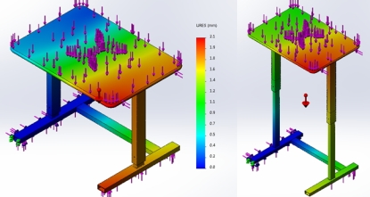
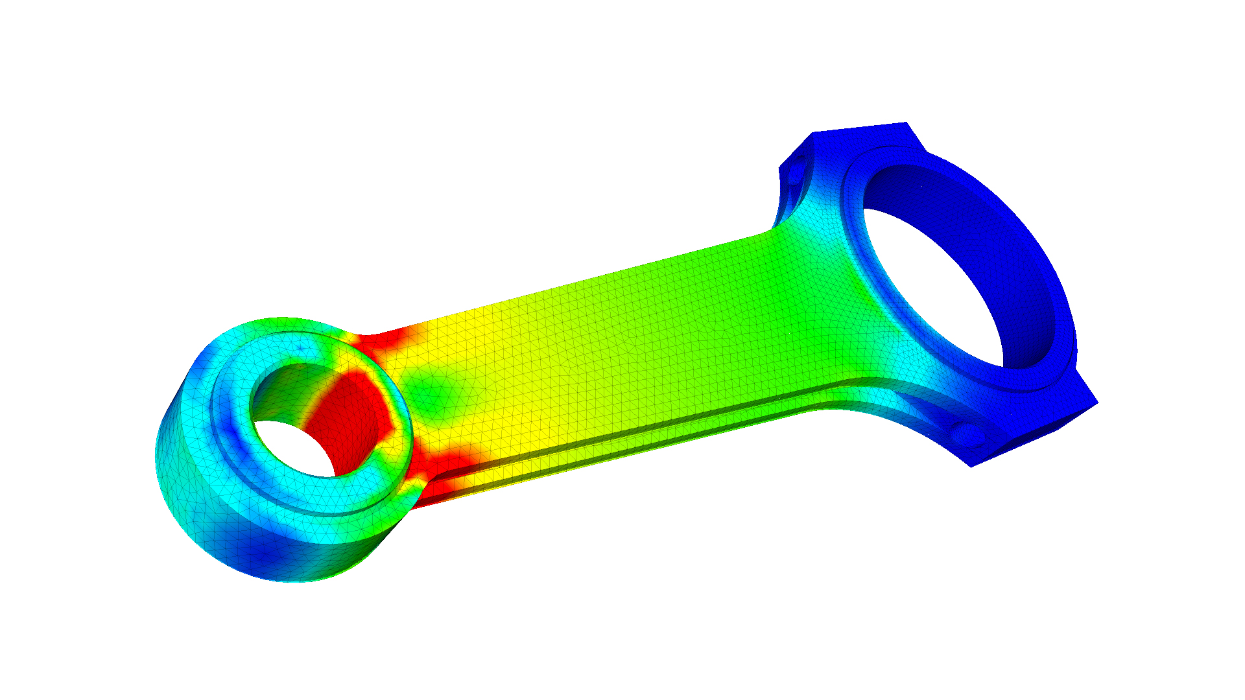
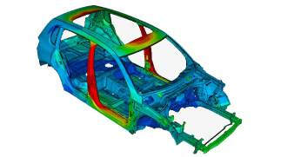
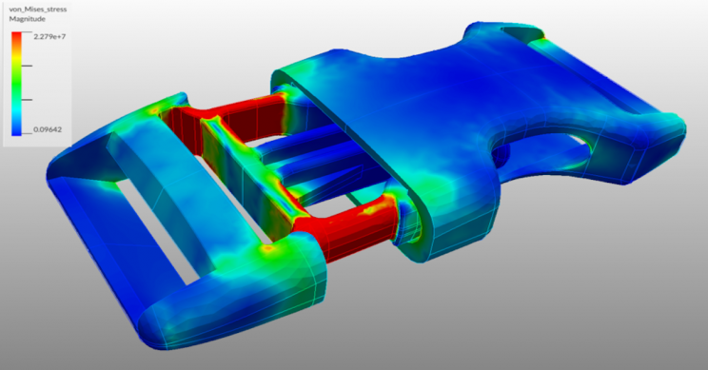
Finite Element Analysis (FEA)
Finite element analysis is a computerized method for predicting how objects react to forces, temperature changes, fluid flow, and other conditions.
In engineering, it is often used to find weak spots in a design.
Notes:
This is exactly what finite element analysis does; it is a computerized method for predicting how objects react to forces, temperature changes, fluid flow, and other conditions. In engineering, it is often used to find weak spots in a design.

Slide 6
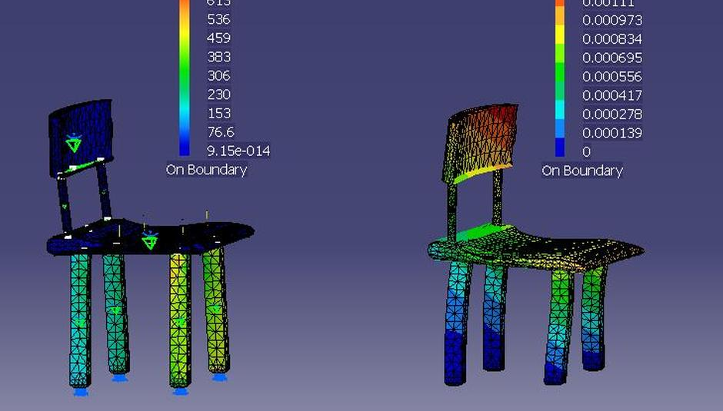
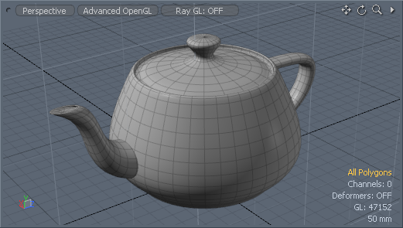
The bigger picture
Problem: weight limit of chair
Object is broken down into discreet geometric shapes (finite elements)
Each finite element will have some equation to describe it
These equations are recombined and assembled into one bigger system that we can solve
Notes:
So what exactly does this look like? Lets assume we have some sort of problem, such as finding out whether we can sit on a chair without breaking it. We said that we have basic components of an object. In this case, the chair has a portion to sit on, the legs, and something to lay your back on. Each part can be further broken up into small geometric shapes. These components are called finite elements. These finite elements all will each have some form of equation to describe them, and then these equations are recombined and assembled into one bigger system that we can solve. You can’t really see the mesh on the chair, but in the image next to it you can really see the squares

Slide 7
History
FEA was developed for civil and aeronautical engineering after World War II
Contributions from 1940s: solve systems of partial differential equations.
1940s:
Alexander Hrennikoff
introduced the concept of using a lattice like approach to objects
Richard Courant
divided an object into finite subregions to solve second order elliptic partial differential equations
50s and 60s: Feng Kang
proposed a finite difference method based on variation principle in order to also solve PDEs
1970s: Finite Element Method
Although it was first implemented into a software, it was later given a rigorous mathematical basis
Notes:
Before we get into the specifics of how exactly this happens, lets go over some brief history.
FEA was developed to solve problems in civil and aeronautical engineering after World War II. Although there isn’t one particular person to credit, many made contributions since the 1940s by creating methods to solve systems of partial differential equations.
In the 1940s, Alexander Hrennikoff introduced the concept of using a lattice like approach to objects, while Richard Courant divided an object into finite subregions to solve second order elliptic partial differential equations. In the 50s and 60s, a Chinese mathematician Feng Kang proposed a finite difference method based on variation principle in order to also solve PDEs. All of these approaches contributed to the development of the Finite element method in the 1970s.
Although it was first implemented into a software, it was later given a rigorous mathematical basis.

Slide 8
Finite Element Method
Discretization strategy
Solution Algorithm
Post Processing Procedure

Slide 9
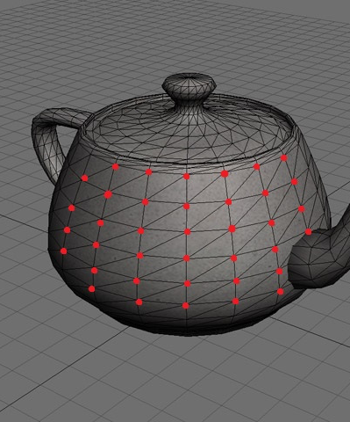
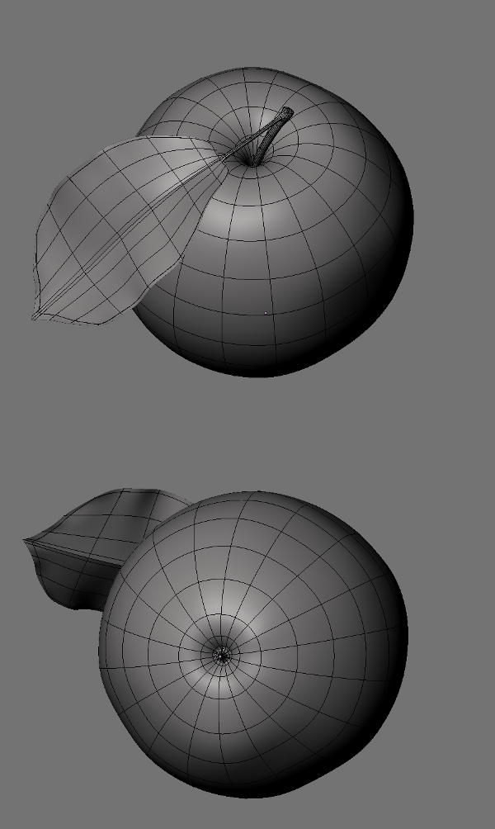
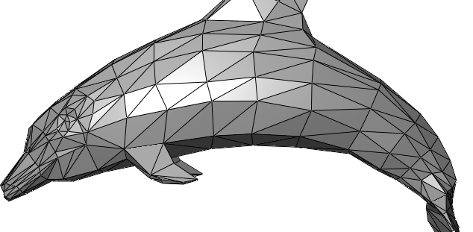
Mesh
Mesh is a discretization of a domain into small shapes
Discretization: Modeling the body of an object by dividing it into finite elements which are interconnected at two or more nodes and/or boundary lines and surfaces.
Nodes are specific points in the finite element. We calculate the displacement, stress, strain, etc. for each node. For example, we need to find the stress at each particular node.
Notes:
A mesh is a discretization of a domain into small shapes
Modeling the body of an object by dividing it into finite elements which are interconnected at two or more nodes and/or boundary lines and surfaces.
Nodes are specific points in the finite element. We calculate the displacement, stress, strain, etc. For example, we need to find the stress at a particular point

Slide 10
Let’s pretend we have some object. How many different ways can we make a mesh?

Slide 11
Let’s pretend we have some object. How can we make a mesh?

Slide 12
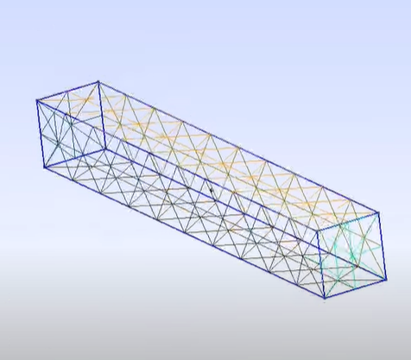
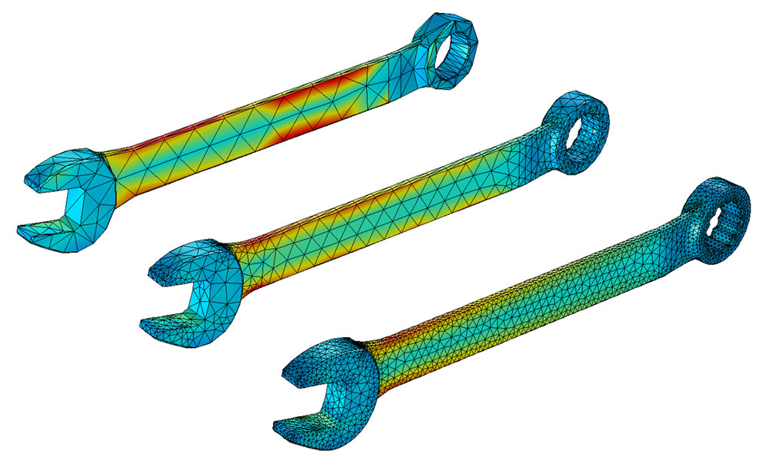
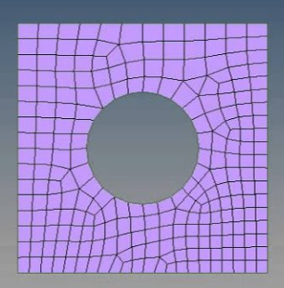
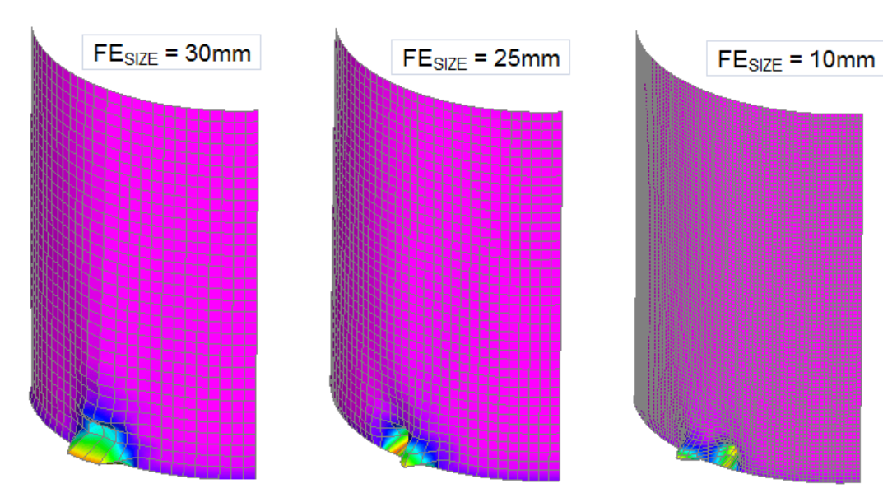
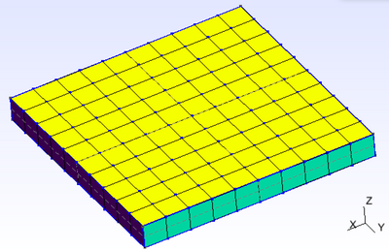
Choosing our discretization strategy
Shape
Dimension
Type
Size
Notes:
As we saw, there are many different ways to make a mesh. We can make different shapes such as triangles, squares, pentagons…whatever works best!
We can also make meshes of different dimensions. We can use 1D elements such as lines, 2d elements such as planes, shells, membranes and shapes, and 3d elements such as cubes. We can also choose between three types of meshes. Structured meshes are meshes in which all vertices are topologically alike. They are used for simplicity and easy data access. Unstructured meshes are meshes in which vertices have arbitrarily varying local neighborhoods. In other words, the vertices are adapted to the object itself and are not uniform. A hybrid mesh is one with small patches of structured meshes which are all combined to form an unstructured mesh. Lastly, we need to choose the size of our mesh. Accuracy of our findings depends on the number of elements we choose to have in the mesh. The smaller we make our elements, the more will make up the mesh. This will have a huge effect on accuracy.

Slide 13
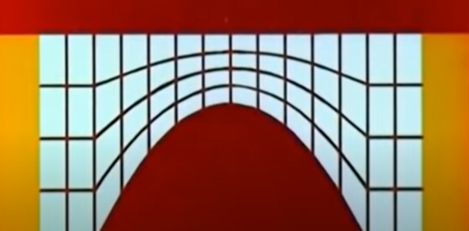
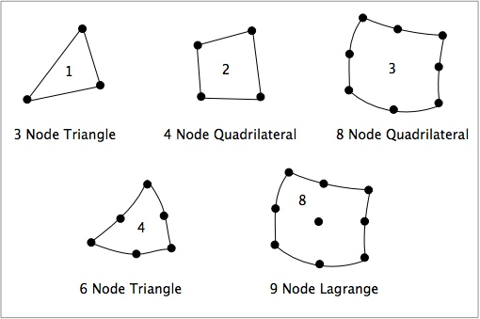
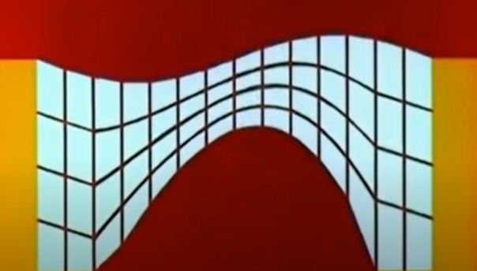
What happens after we build a mesh?
Notes:
So now that we have built our mesh, we need to find the defining features. In other words, we need to obtain a set of algebraic equations and solve for some unknown quality such as displacement, stress or strain. But how do the nodes and mesh incorporate into this?
Lets look closer at the elements themselves. Lets say we have an object with 2d quadrilateral nodes. As we can see, the element has 8 nodes. Because this is a 2d element, each node can move horizontally or vertically in this example, with the exception of defining boundary points on an object. For example, if we have a 2d bridge that can’t move on the right and left areas, we set these as fixed nodes. Everything else can move if the conditions we apply on the object make the object change.
Another important thing to note is that the smaller the mesh elements are, the more accurate the overall solution is. However, this compromises computing time, as more calculations need to be made.

Slide 14
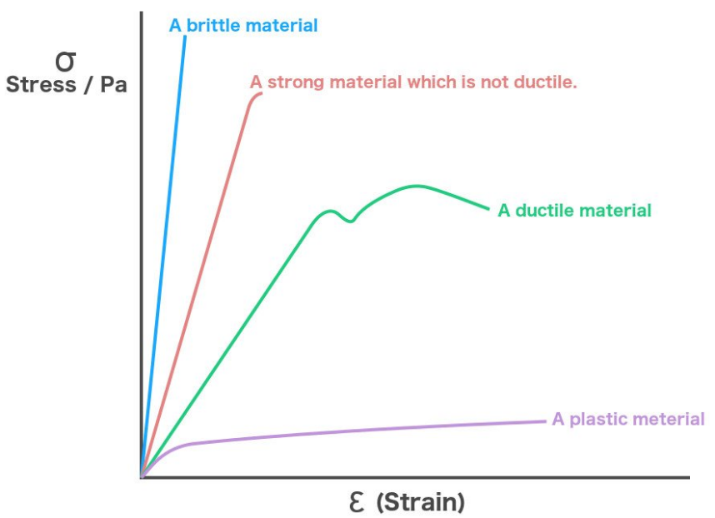
Materials and Elasticity
Stress: the deforming force per unit of area
Strain: the change in shape of the original object
Notes:
The last thing we need to define is the material of our object. Earlier, we spoke of the difference between kicking the metal piece of the car and the window. One has greater elasticity than the other, and thus one is less likely to break than the other. I have been throwing around the words stress and strain. Stress is the deforming force per unit of area while strain is the actual change in shape of the original object. We can see in the graph that a brittle material can undergo a lot of stress with little strain while a fairly ductile material such as plastic undergoes a lot of strain at a little stress.

Slide 15
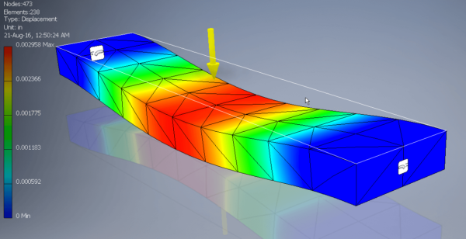
Notes:
Lets pretend we put a load on an object at a particular point. Our FEA wants to describe the whole system in an equation which can tell us about the structural changes caused by the downwards force

Slide 16
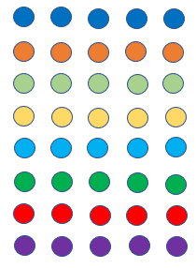
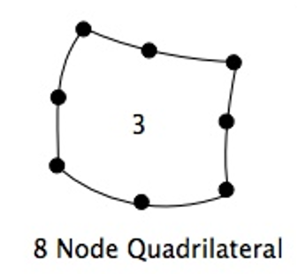
From Nodes to Linear Algebra: The Stiffness Matrix
Notes:
This equation starts at the fundamentals: it looks at the displacement of any node. Each node has an equation that describes its displacement as a function of its coordinates. If we look back at our quadrilateral element, we can derive eight equations from it. These eight equation then form a matrix. The fundamental laws of mechanics are then applied to the matrix. Displacement is related to stress, and stress is related to strain, and then from strain we can derive potential energy. Minimum potential energy can tell us a lot about a system since we know the system is stable if the potential energy is at its minimum.

Slide 17
Repetition and Reduction
E1 E2 … En
We solve the matrix equations until we are left with one single node solution. Then, we can use our one solution to figure out all the other nodes’ solutions!
Notes:
This process gives us a system of equations for the element.
The new matrix is called the stiffness matrix. The matrix operates on vector x and y whose components are the displacements for the whole element. By looking at the displacement of nodes relative to their position, stress contours can be determined.
This process is carried on for every element in the mesh. Every stiffness matrix is then combined into a single large matrix representing the stiffness of the whole system. Because nodes for two elements are shared, the values will be found in both matrices.
In order to simplify the matrix, the equations are solved. Each equation is then substituted into the remaining ones. This continues until we are left with the solution for a single node. This result is then used to find the values for all the other nodes.

Slide 18
Notes:
Thus, we can find the stresses for each area in this manner, and plot them colorfully. Red is area of greatest compression and blue is area of greatest tension.
The process can be repeated with the load at a different point.

Slide 19
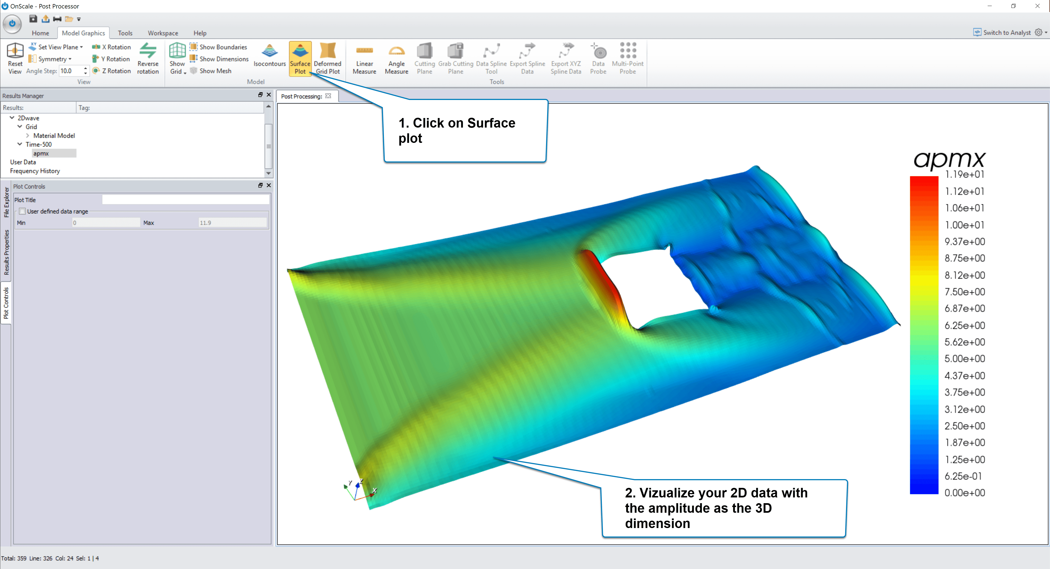
Post Processing
Check for Errors within Displacements, Strains, and stresses
Do some concept check calculations by hand
Plot information
Print or sort according to needs
Animate if necessary
Notes:
So now that we have subdivided our object and selected a solution algorithm, we can talk about post processing. First, we must run for a check for problems that occurred during the solution. This can include on paper sanity checks or other post processing software. Then information can be presented as necessary; we can print, sort, animate, or graph anything we want with our data.

Slide 20
But…what about the math??
FEA: taking a system governed by differential equations and partitioning it into elements that can individually be solved with simple linear equations. With these partitions, we attempt to make a linear approximation as close as possible to the continuous solution.
Notes:
So far ive been very theoretical about the entire process. Im not going to lie, the math for these analyses can get very very complicated, so we will cover a little bit of it only- FEA can have a lot of complicated partial differential equations. The process of FEA essentially is FEA: taking a system governed by differential equations and partitioning it into elements that can individually be solved with simple linear equations. With these partitions, we attempt to make a linear approximation as close as possible to the continuous solution.

Slide 21
Boundary Problems
Most engineering applications are represented with differential equations with constraints called boundary conditions
For simple geometries, we use analytical methods such as integration, Laplace transforms, etc.
But how do we handle complex geometries?
We need a numerical method that takes differential equations and boundary constraints and turns them into linear functions
Notes:
Most engineering applications are represented with differential equations with constraints called boundary conditions
For simple geometries, we use analytical methods such as integration, Laplace transforms, etc.
But how do we handle complex geometries?
We need a numerical method that takes differential equations and boundary constraints and turns them into linear functions

Slide 22
Basic Steps
Establish Strong Formulation of Equations
Obtain weak formulation/weighted residual/variational statement
Choose approximations for unknown functions
Choose basis function
Solve
Notes:
Usually, we just create our mesh and define our boundaries in our FEA solver…but what if we wanted to try doing it ourselves or perform a sanity check?
There are a few steps to the Finite Element Method. We have to establish a strong formulation of equations, obtain a weak formulation, Choose approximations for unknown functions, Choose a basis function, and Solve.

Slide 23
Establishing a strong formulation with Poisson Equation
Notes:
Lets assume we have this shape where the outer boundary is gamma and inner region is omega. Step one of our method is to establish a strong equation. A strong form is a conventional differential equation while the weak form is an alternate representation of the differential equation. While strong form solutions must be continuous and differential, weak form solutions have larger sets of functions. Lets say our strong differential equation for this particular problem is a poisson equation. Lets assume u^e (x,y) is the exact solution to this equation

Slide 24
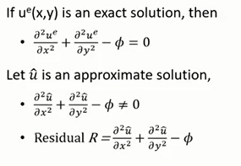
Obtain a weak formulation using approximation
It is easier to solve the weaker formula
Start with strong form and multiply by a test function
Integrate the whole equation over the domain
Notes:
It will be very difficult to find an exact solution in the real world…lets find an approximate solution. We see that the approximate solution won’t exactly satisfy the poisson equation. We need to find an approximate solution u hat such that R is close to zero at each point within domain omega. In order to make R close to zero, we need to find the weighted residual statement, otherwise known as the weak formulation. Jere, we integrate the whole equation over the domain. We end up with this as our weak form.

Slide 25
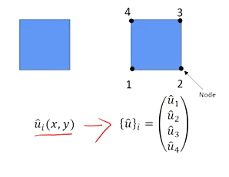
Discretization with Basis Functions
Basis functions are the functions that are multiplied by the coefficients and added to form a solution
Basis function can be linear, quadratic, cubic…as we said before, the shape, amount, and dimension of our elements is chosen in context of the problem!
Notes:
Let’s isolate one element with function U i hat. Rather than dealing with a function, we could deal with an array of numbers. Thus, we see that each node has its own equations that can be put into a matrix form. In order to make this into a matrix, we can use Pieceiwise extrapolation. N1,N2,N3,N4 are the known basis functions that depend on the shape of the element. Basis functions are functions that are multiplied by the coefficients and added to form a solution. Basis function can be linear, quadratic, cubic…as we said before, the shape, amount, and dimension of our elements is chosen in context of the problem!
The u hats are unknown numbers that we want to solve for. If we substitute this into the weak form, we get a linear system of equations.

Slide 26
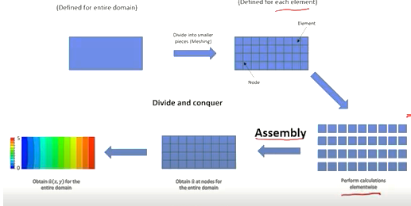
Solving
Notes:
Once we substitute into the weak form and have converted this one element into a linear element, we need need to add all the elements together. So we get this equation, K stands for the stiffness matrix, F is the global force, and U are the node values. Thus, with all the u hats in the domain, we can make our contour lines and move to post processing.

Slide 27
Post Processing
Mesh Convergence is one of the most important factors that affect accuracy
In order to verify that the size of our elements is correct, we need to know that increasing the quantity of elements hardly affects the solution. In other words, as the number of elements goes towards infinity, the solution should converge to a specific value.
Convergence can be measured by comparison with experimental results or comparison with other analytical solutions
Errors in Displacement:
Errors in Strains:
Errors in Stresses:

Slide 28
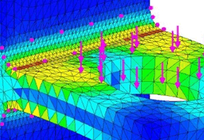
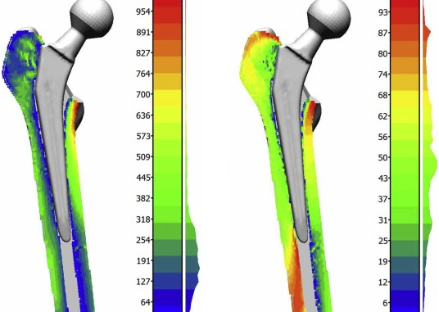
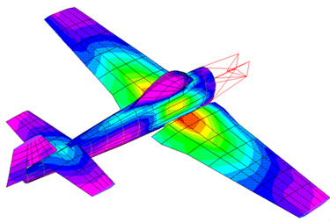
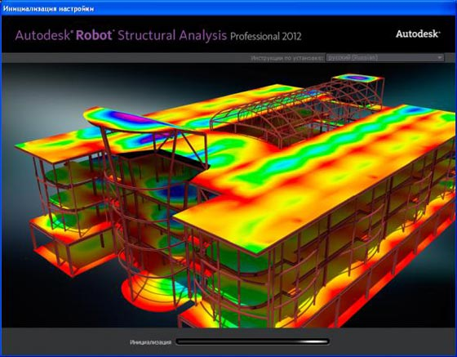
Applications of FEA
Thermo-mechanical, thermo-chemical, ferroelectric, electromagnetic, fluid structure, flow analysis, structural analysis problems
Civil Engineering and Geology: Innovative Building Materials and Structures, sedimentation/erosion/hydrology, slope stability, seepage of fluids in soils and rocks
Bio-Engineering: Simulation of human organs, testing medical devices and implants
Electronics: Heat analysis in electrical equipment, insulation design analysis
Mechanical engineering: Manufacturing process simulation, automotive design
Meteorology: Climate Predictions, wind prediction, monsoon prediction
Computer Science: Someone has to code the simulations!

