Slide 1
Fourier Transform And RSA
Nathan Conger

Slide 2
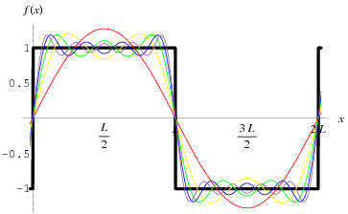
Joseph Fourier (1768-1830)
Looked at heat diffusion (1822; The Analytical Theory of Heat )
Showed that many functions can be expressed in terms of an infinite series of trigonometric functions (Fourier Series).
https://www.britannica.com/biography/Joseph-Baron-Fourier
https://mathworld.wolfram.com/FourierSeries.html

Slide 3
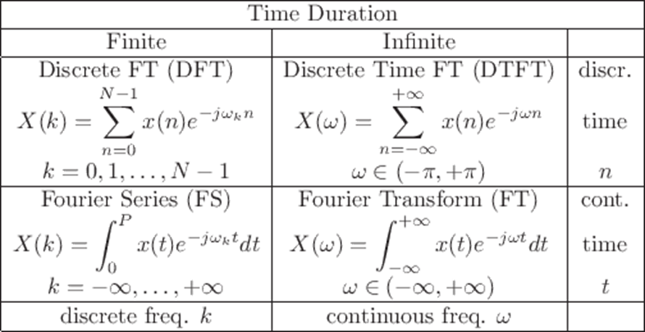

Slide 4
What is the Fourier Transform?
Decomposing frequency into its constituent parts Desmos Demo
https://community.sw.siemens.com/s/article/what-is-the-fourier-transform

Slide 5
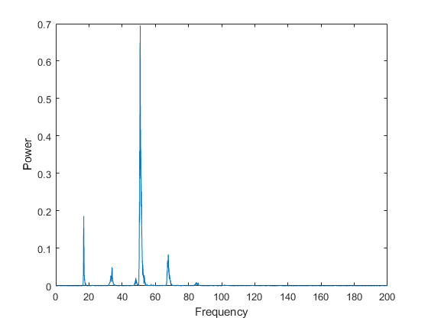
https://www.mathworks.com/help/matlab/math/fourier-transforms.html#:~:text=Use%20a%20time%20vector%20sampled,a%20period%20of%2010%20seconds.&text=Compute%20the%20Fourier%20transform%20of%20the%20signal%2C%20and%20create%20the,)*50%2Flength(y)%3B

Slide 6
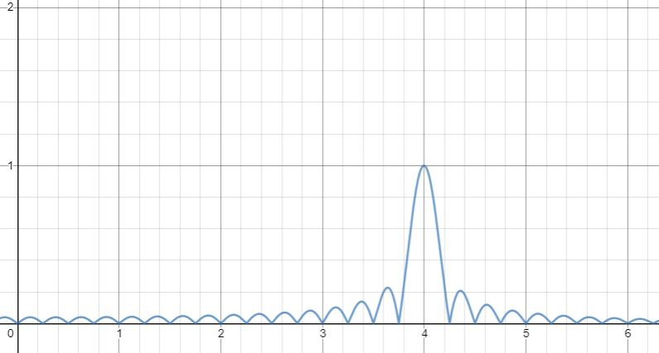
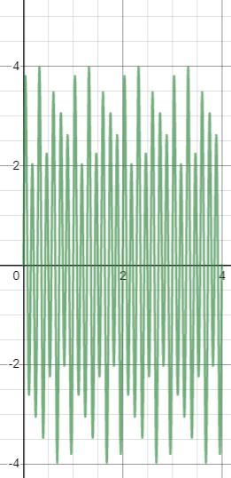
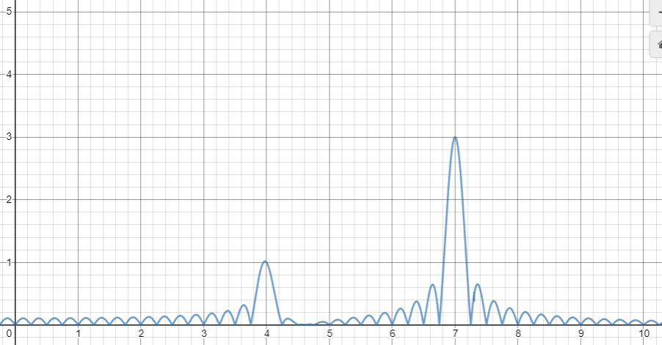
Audio Correction
2
Flatten annoying sound
3
Apply Inverse Fourier Transform
1
Apply Fourier Transform

Slide 7
RSA Encryption
RSA encryption uses 2 keys:
a Public key $P=p_{1}p_{2},$ where $p_{1}p_{2}$ are distinct prime
and a Private key generated by the prime numbers $D=φ(P$))
The strength of RSA comes from it being immensely difficult to find factors of large numbers.
Using the quantum form of the Fourier transform, we can break RSA encryption super quickly using Shor’s Algorithm

Slide 8
Shor’s Algorithm
Objective: Get the prime factors $p_{1},p_{2}$ of the Public RSA key N.
Algorithm: Let $g$ be some initial guess, $1<g<N$,
If g$|N$, then we’re done. $p_{1}=g, p_{2}=\frac{N}{g}$
Otherwise, use Euclid’s algorithm to check if $\gcd\left(g,N\right)>1$.
For any coprime $g,N, g^{p}=m∗N+1$ for some $p∈\text{ℕ}$.
Can be arranged to ${(g}^{\frac{p}{2}}−1{ )(g}^{\frac{p}{2}}+1)=m∗N$
Find an even $p$such that ${(g}^{\frac{p}{2}}−1{ )(g}^{\frac{p}{2}}+1)=m∗N$ and ${ (g}^{\frac{p}{2}}−1)\text{∤} \text{N}$ or${ (g}^{\frac{p}{2}}+1\text{)}\text{∤} \text{N}$
Use Euclid’s algorithm (on each of our new guesses with N to get $p_{1},p_{2}$ .
The difficulty comes with finding $p$
$p$ can be found in to 20-30 runs of the algorithm (reduced to 4-8 runs with modifications )
https://en.wikipedia.org/wiki/Shore

Slide 9
Finding p
Quantum computing is probabilistic. I can take make multiple computations simultaneously and get out each output weighted with some probability. “Observing” the output collapses the probabilities together to get a single output.
Input: $\text{|}\text{1, 0}\text{⟩}\text{+}\text{|}\text{2}\text{,} \text{0}\text{⟩}$+ $\text{|}\text{3}\text{,} \text{0}\text{⟩}\text{+}…\text{ =>}$ $g^{x} mod \left(N\right)⇒$output: $\text{|}\text{1,} r_{1}\text{⟩}\text{+}\text{|}\text{2,} r_{2}\text{⟩}\text{+} \text{|}\text{3,} r_{2}\text{⟩}\text{+}…, 0≤r_{i}<N, ∀ i$
Measure remainder state. This partially collapses output state into $\text{|}a_{1}, { r}_{i}\text{⟩}\text{+}\text{|}a_{2}, { r}_{i}\text{⟩}\text{+}\text{|}a_{3}, { r}_{i}\text{⟩}\text{+...}$
Output is superposition of all inputs with remainder is $r_{i}$
Property: $g^{p}=m∗N+1$ and ${ g}^{x}=m_{2}∗N+r$, then $g^{x+np}=m_{3}∗N+r, ∀n∈$ ℤ. $p$ is periodic
Our previous output really is: $\text{|}a_{1}, { r}_{i}\text{⟩}\text{+}\text{|}a_{1}+p, { r}_{i}\text{⟩}\text{+}\text{|}a_{1}+2p, { r}_{i}\text{⟩}\text{+...}$
Input the superposition $\text{|}a_{1}, { r}_{i}\text{⟩}\text{+}\text{|}a_{1}+p, { r}_{i}\text{⟩}\text{+}\text{|}a_{1}+2p, { r}_{i}\text{⟩}\text{+...}$ into Quantum Fourier Transform gets the superposition: $\text{|}\frac{1}{p}\text{⟩}\text{+}\text{|}\frac{2}{p}\text{⟩}$+$\text{|}\frac{3}{p}\text{⟩}\text{+}…$. Measuring the output collapses it to $\text{|}\frac{c}{p}\text{⟩}$for some $c$. Repeating the calculation yields different outputs, so using gathered QFT data, we can calculate $\frac{1}{p}$

Slide 10
Shor’s Example
Suppose we want to factor 15.
1) Choose a random guess, say 2.
2)Input superposition $\text{|}\text{1, 0}\text{⟩}\text{+}\text{|}\text{2}\text{,} \text{0}\text{⟩}$+ $\text{|}\text{3}\text{,} \text{0}\text{⟩}\text{+}…\text{ =>}$ $2^{x} mod \left(N\right)⇒$output: $\text{|}\text{1,} \text{ +2}\text{⟩}\text{+}\text{|}\text{2,} \text{+4}\text{⟩}\text{+} \text{|}\text{3,} \text{+8}\text{⟩}\text{+}…$
3) Measure for remainder. Collapses into superposition with random remainder, say 2.
Output: $\text{|}\text{1}\text{, 2}\text{⟩}\text{+}\text{|}\text{5, 2}\text{⟩}\text{+}\text{|}\text{9}\text{,}\text{ 2}\text{⟩}$+$…$
4) Input into QFT $⇒$ $\text{|}\frac{1}{p}\text{⟩}\text{+}\text{|}\frac{2}{p}\text{⟩}$+$\text{|}\frac{3}{p}\text{⟩}\text{+}… ⇒$ after repeated measure and recalculation $⇒$ $\frac{2}{4}\text{, }\frac{5}{4}$, $\frac{7}{4}$ , … $⇒$ 4, even
5) $g_{1}^{′}=(2^{\frac{4}{2}}−1)=3, g_{2}^{′}=(2^{\frac{4}{2}}+1)=5$
6) Euclidean Algorithm: $\gcd\left(3, 15\right)=3 ⇒p_{1}=3, p_{2}=\frac{15}{3}=5$

Slide 11
References
https://www.britannica.com/biography/Joseph-Baron-Fourier
https://community.sw.siemens.com/s/article/what-is-the-fourier-transform
https://sites.math.washington.edu/~morrow/336_16/2016papers/tristan.pdf
https://riliu.math.ncsu.edu/437/notes3se4.html
https://www.quantiki.org/wiki/shors-factoring-algorithm
https://www.geeksforgeeks.org/rsa-algorithm-cryptography/

