Slide 1
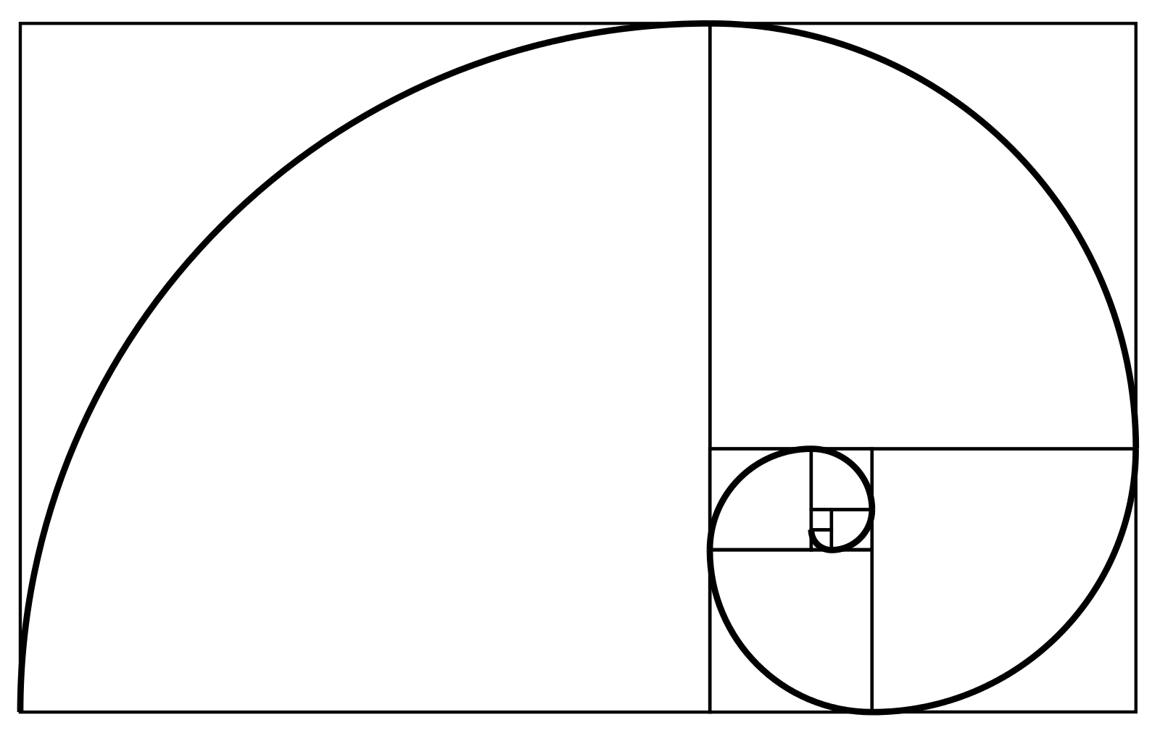
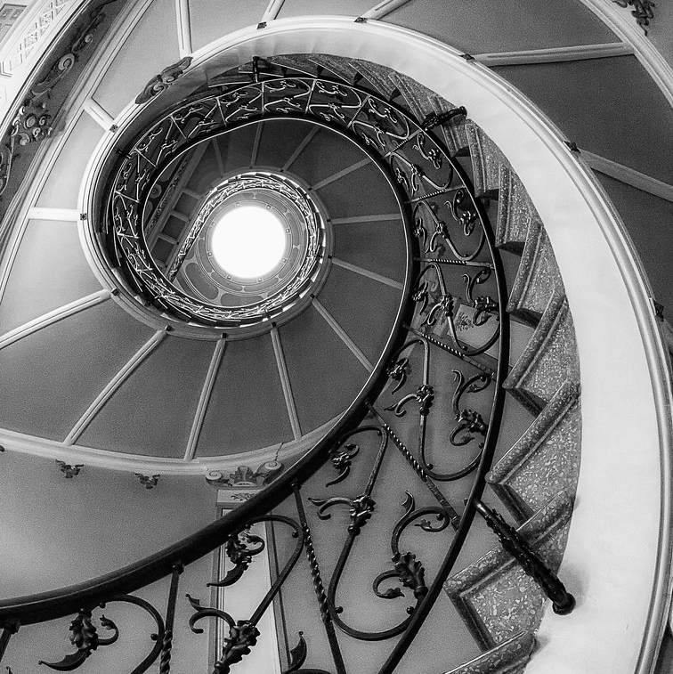
The Golden Ratio
Abigail Van Essendelft
Image Credit: "Golden ratio" by Carabo Spain

Slide 2




Golden Ratio
Golden Ratio:
  Defined $φ= \frac{a}{b}=\frac{a}{a+b}≈1.618$ where $a+b$ is a line segment and $a>b$
Calculation
$a+b$:
$$a$$
$$b$$
By the Quadratic Formula:

Slide 3
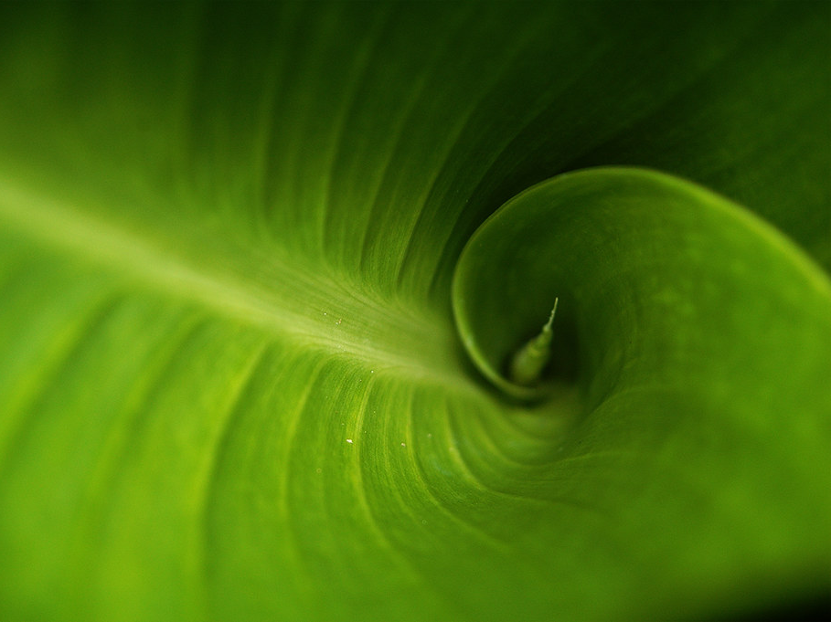
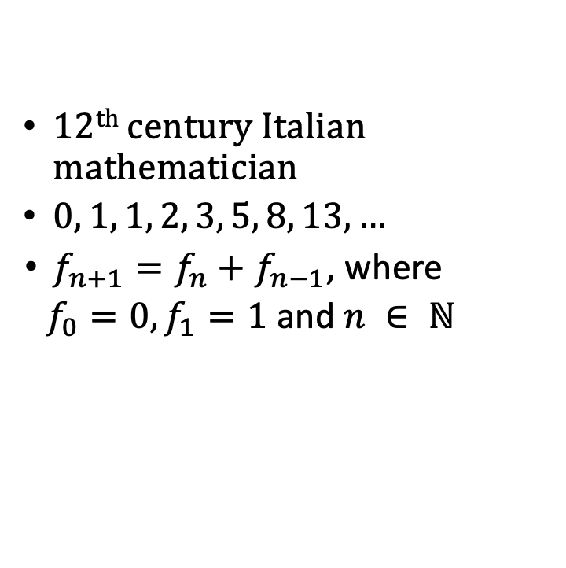
Fibonacci Sequence
  12th century Italian mathematician
  $0, 1, 1, 2, 3, 5, 8, 13, …$
  $f_{n+1}=f_{n}+f_{n−1}$, where
  $f_{0}=0, f_{1}=1$ and $n ∈ ℕ$
"fibonacci green" by Mark Strozier

Slide 4

Golden Ratio and Fibonacci Sequence
Consider: $0, 1, 1, 2, 3, 5, 8, 13, …$
1 | 2 | 2/1 | 2
2 | 3 | 3/2 | 1.5
3 | 5 | 5/3 | 1.666
5 | 8 | 8/5 | 1.6
8 | 13 | 13/8 | 1.625
… | … | … | …
144 | 233 | 233/144 | 1.62805
233 | 377 | 377/233 | 1.61802
… | … | … | …

Slide 5
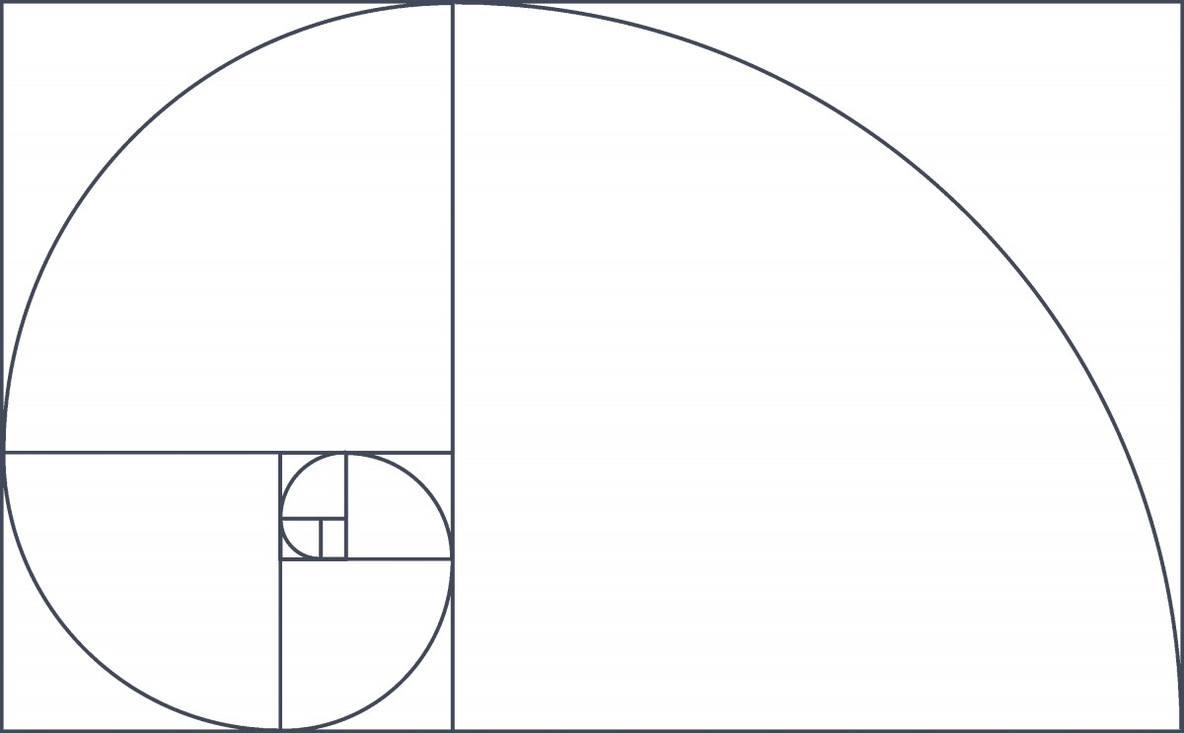







Golden Spiral
$$21$$
$$54$$
$$3$$
$$5$$
$$2$$
$$13$$
$$8$$

Slide 6
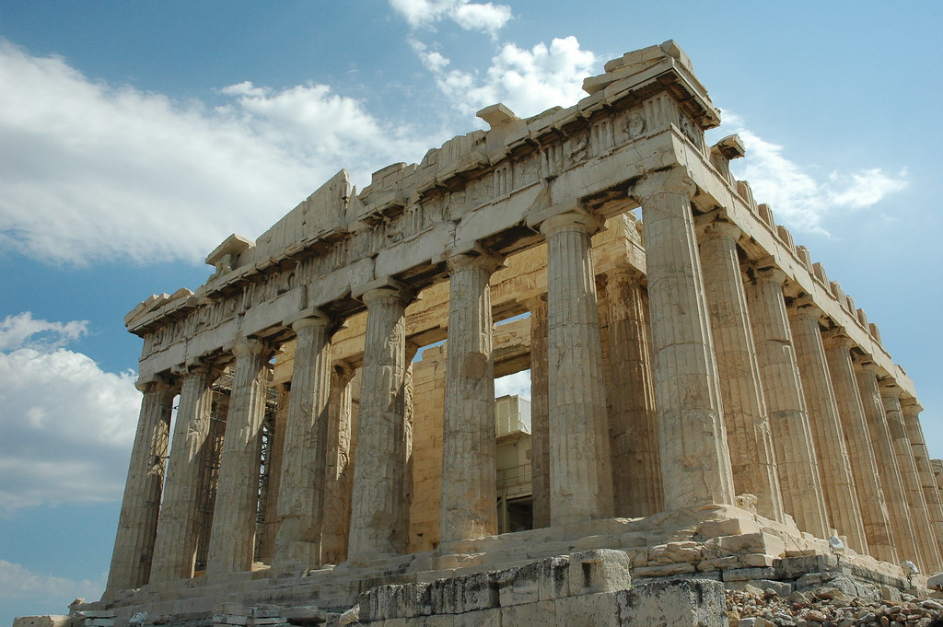
Phi for Phidias
"Parthenon" by Mr G's Travels

Slide 7
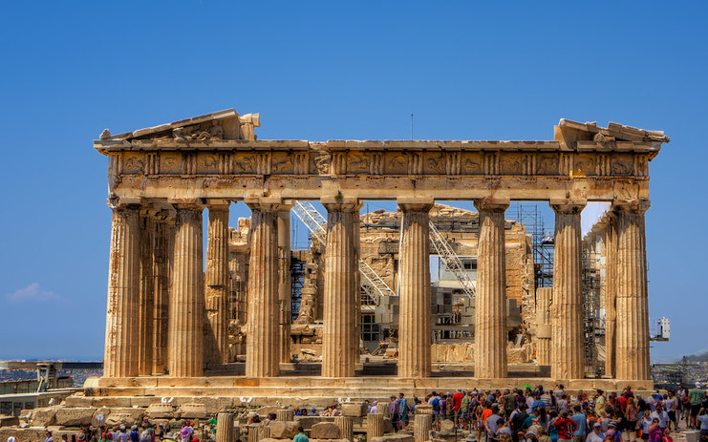
"Parthenon, Athens" by szeke

Slide 8
“Mathematics is the language in which God has written the Universe.”
(Galileo Galilei)

Slide 9
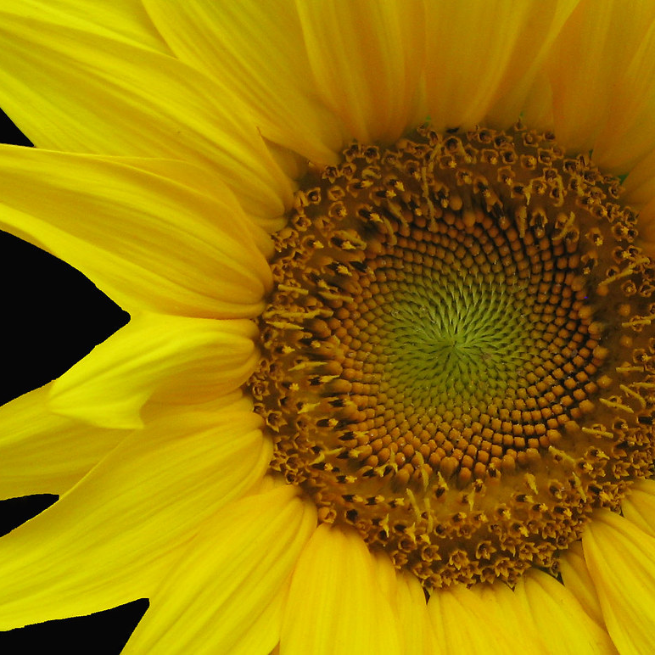
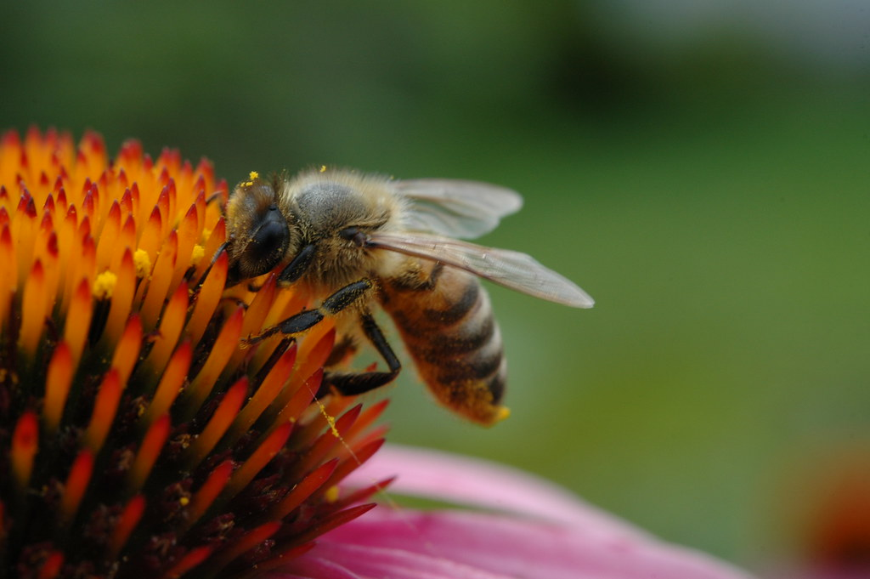
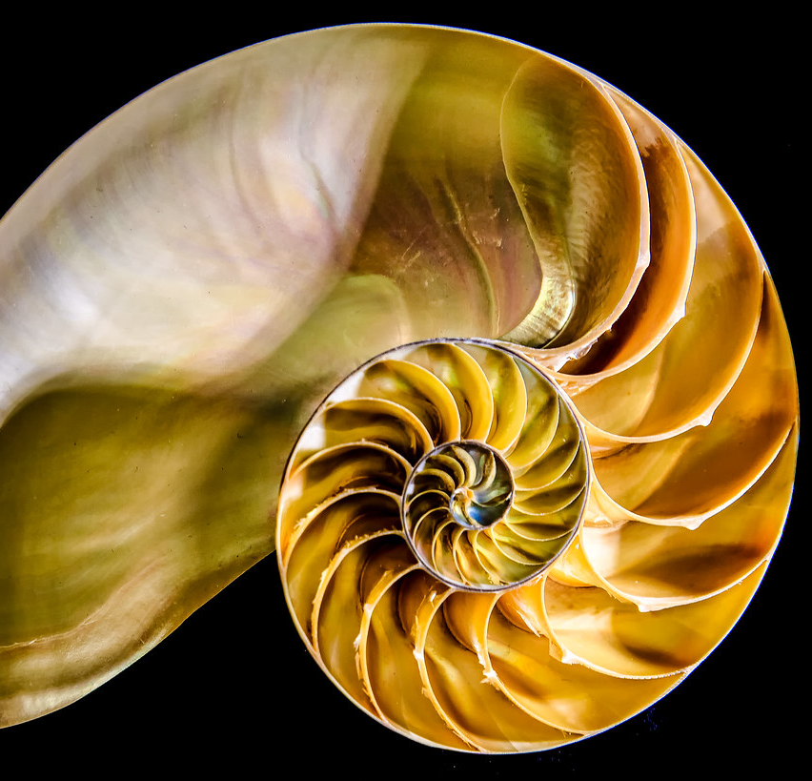
"200907011 Honey Bee 024" by cygnus921
"'Mathematics on Main Street' by My Lovely Wife" by Puzzler4879
"Nautilus Shell" by sailor_smb

Slide 10
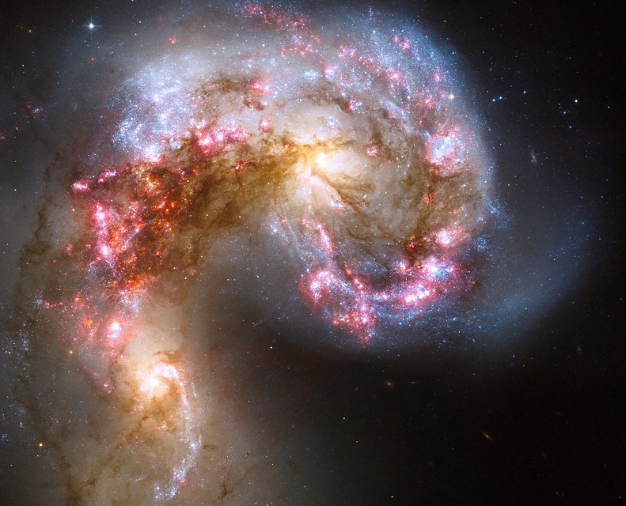

Slide 11
The Language of the Universe
Question: We find that mathematical structures seem inherent to the natural world so, is mathematics something that we made to explain the world around us or was mathematics something that has always been there?

Slide 12
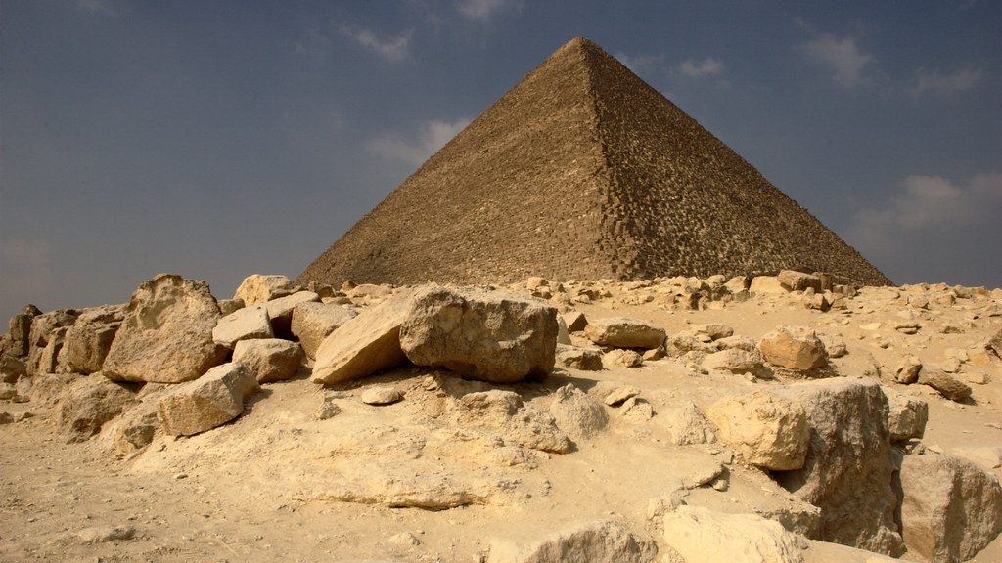
The Great Pyramid of Khufu
Seven World Wonders
13 acres
20 year build
"Great Pyramid of Khufu" by Scott SM

Slide 13
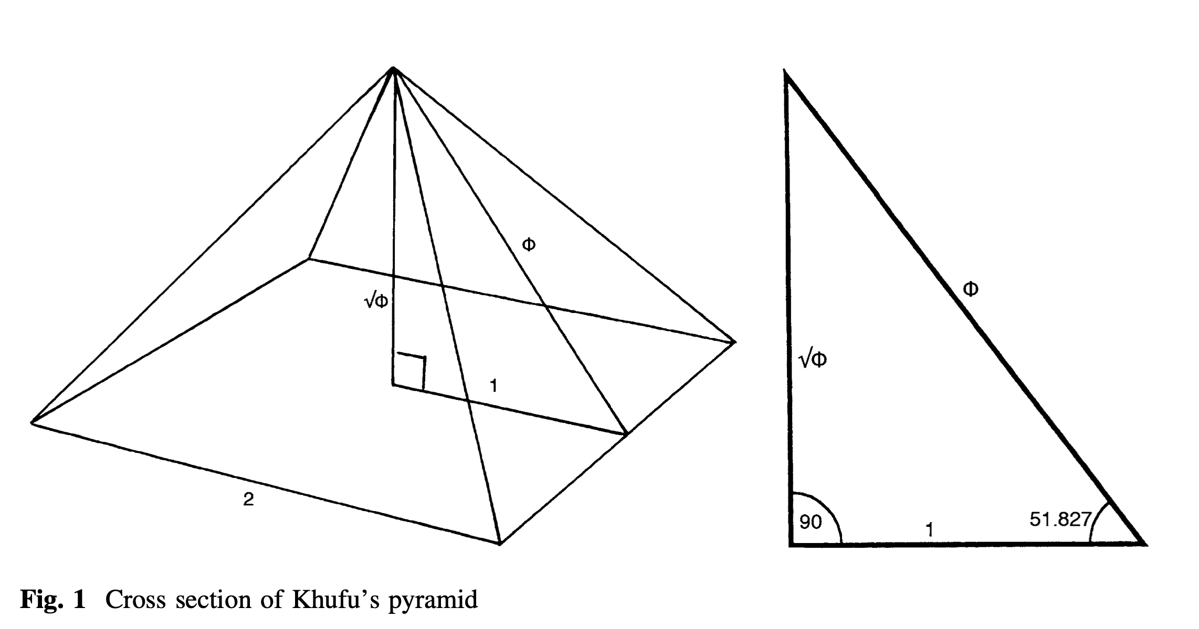
The Great Pyramid of Khufu
Data from: Cole (1925), Dorner (1981), and Lehner (1997)
  Height: 146.515m
  Base: 230.363m

Slide 14
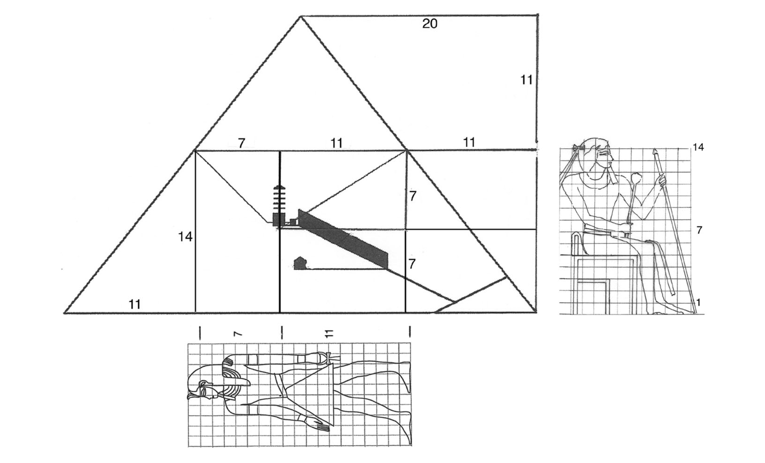
The Great Pyramid of Khufu

Slide 15
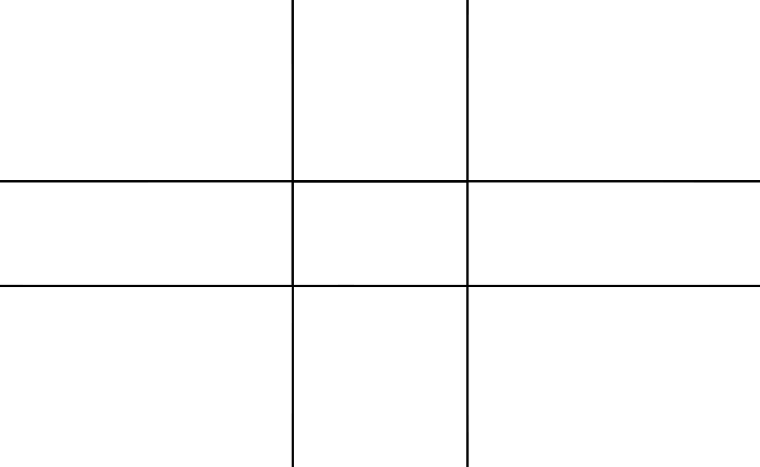
Techniques in Art and Photography
Phi Grid:
Golden Spiral:
1
.618
1
.618

Slide 16
“Nature is the source of all true knowledge. She has her own logic, her own laws, she has no effect without cause nor invention without necessity.” (Leonardo da Vinci)

Slide 17
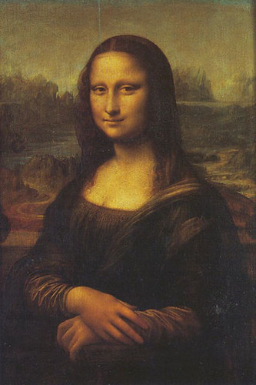
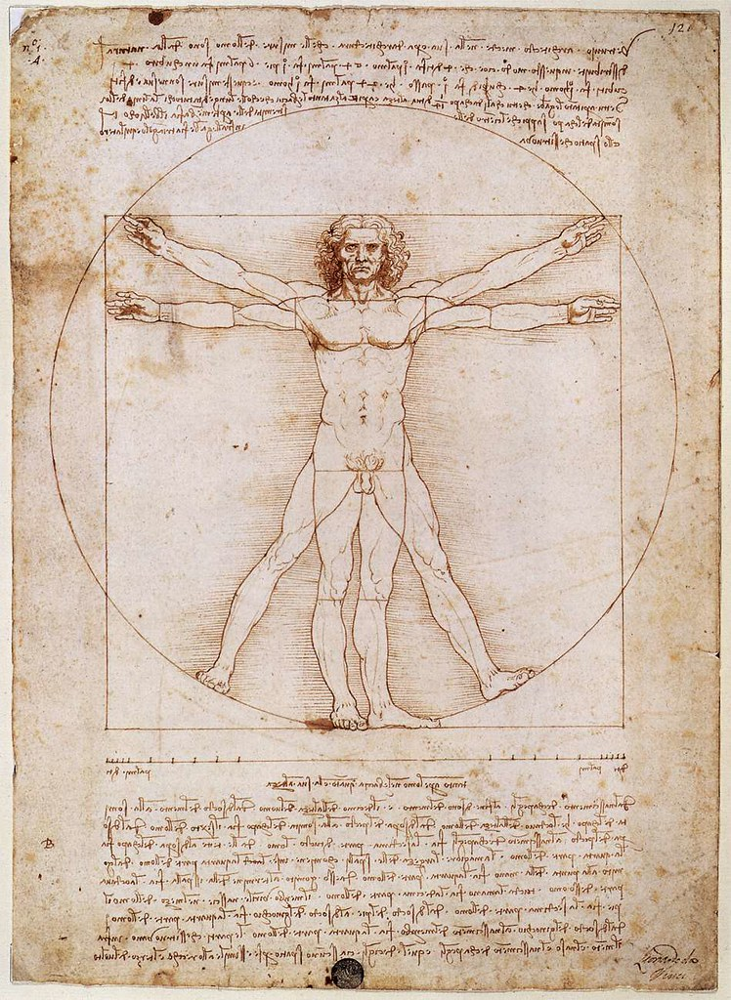
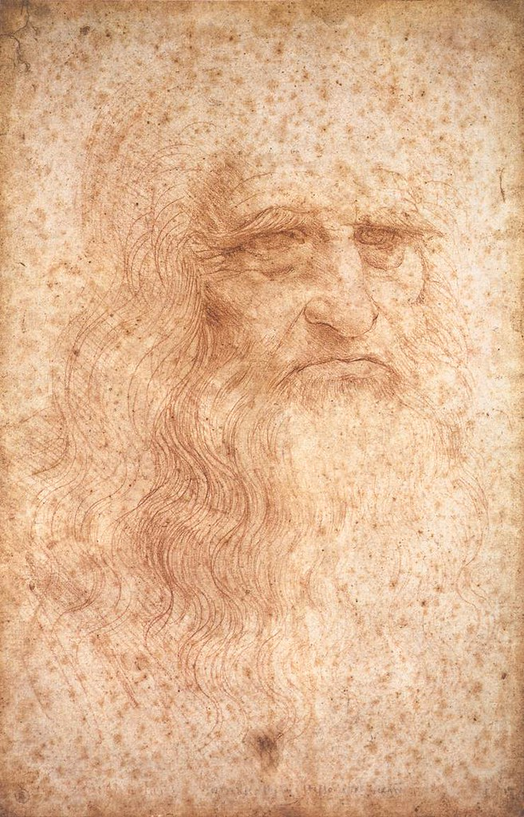
Last supper By Leonardo da Vinci courtesy of Wikipedia
"Leonardo da Vinci, Vitruvian Man (Gallerie dell'Accademia, Venice)" by Leonardo da Vinci courtesy of Emme Debi
"Leonardo da Vinci, Self-portrait (Biblioteca Reale, Turin)" by Leonardo da Vinci courtesy of Emme Debi
"Mona Lisa" by Leonardo da Vinci courtesy of Joaquín Martínez Rosado

Slide 20
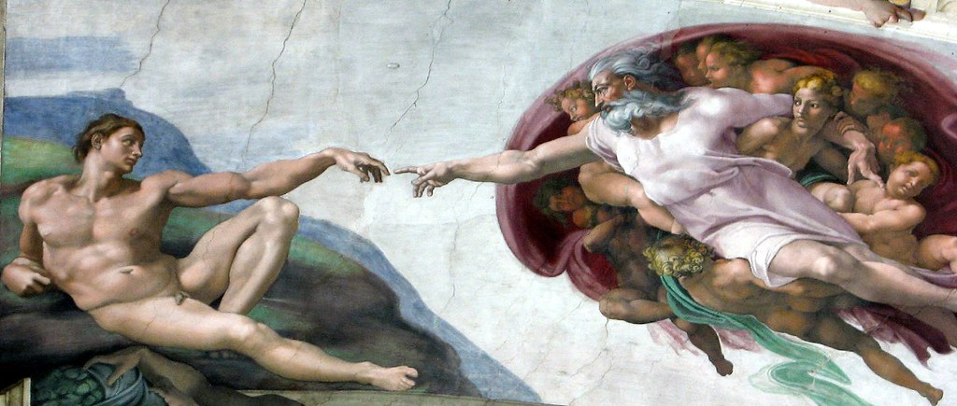
"Michelangelo - The Creation of Man" courtesy of Pierre Metivier

Slide 22
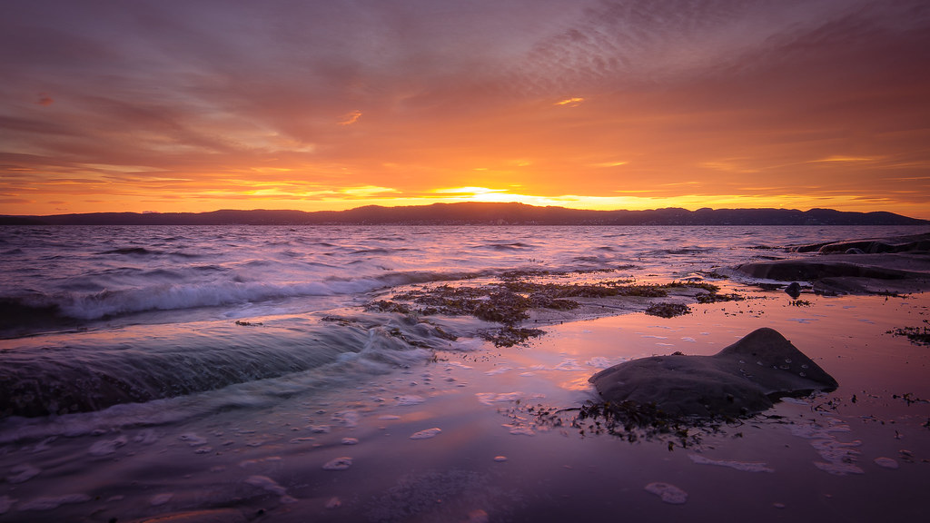
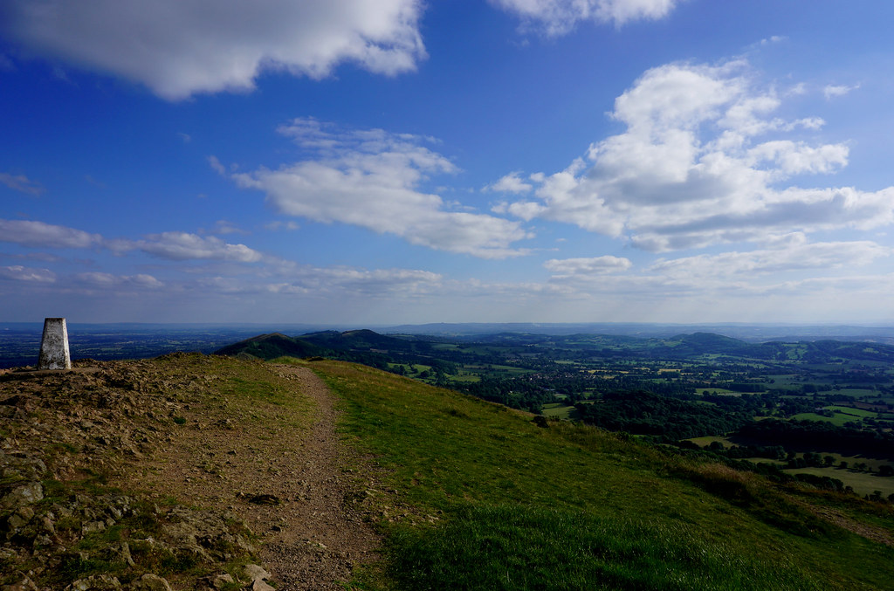
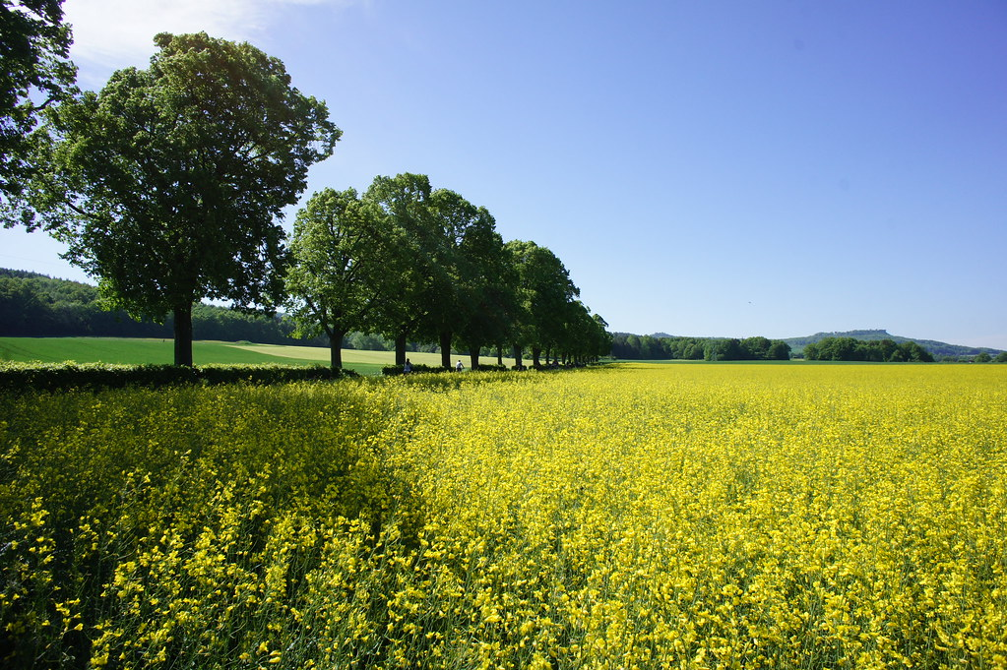
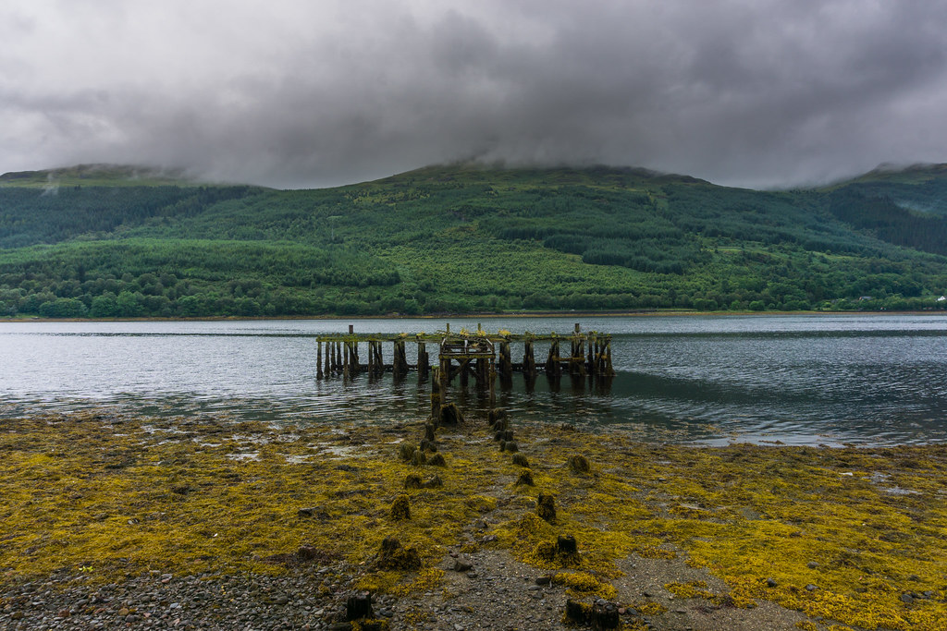
Put Your Intuition to the Test
"Have a good summer!" by Vegar S Hansen Photography is licensed with CC BY-ND 2.0
"landscape" by barnyz is licensed under CC BY-NC-ND 2.0
"landscape" by barnyz is licensed under CC BY-NC-ND 2.0
"landscape" by barnyz is licensed under CC BY-NC-ND 2.0

Slide 23
Put Your Intuition to the Test

Slide 24
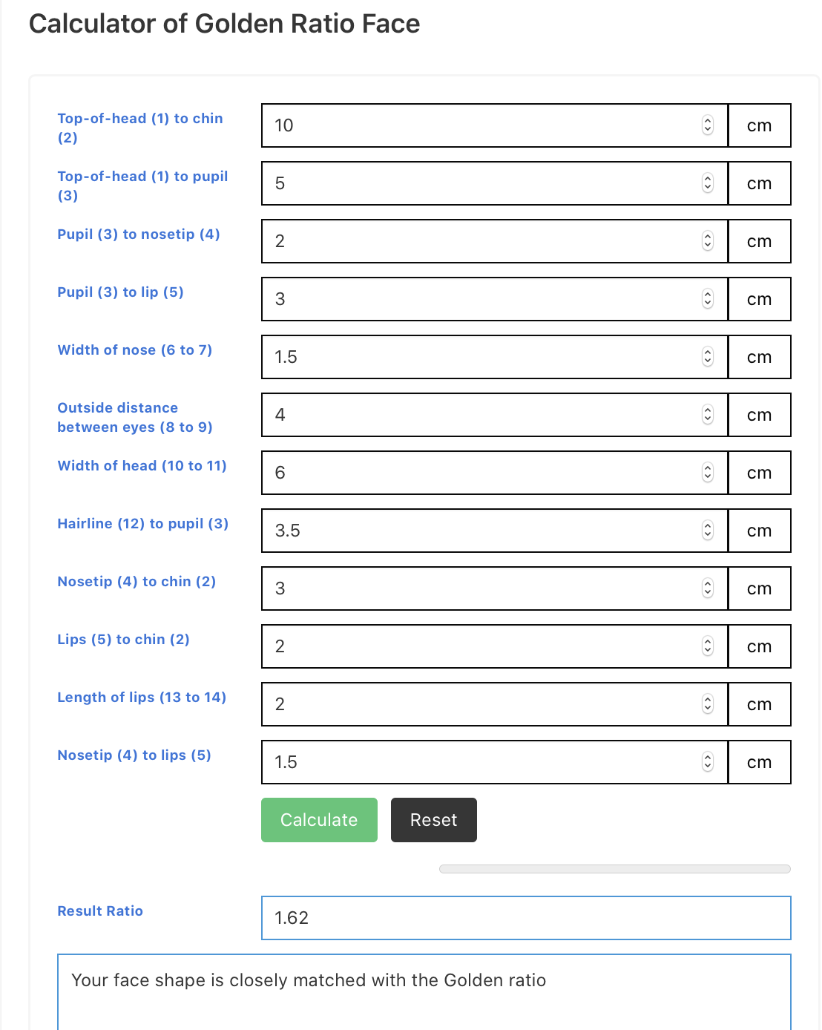
Extending the Golden Ratio
https://wpcalc.com/en/golden-ratio-face/comment-page-1/#comments
https://golden-ratio.club
https://www.ted.com/talks/eddie_woo_how_math_is_our_real_sixth_sense

Slide 25
Works Cited
Bartlett, Christopher. “The Design of The Great Pyramid of Khufu.” Nexus Network Journal: Architecture & Mathematics, vol. 16, no. 2, Aug. 2014, pp. 299–311. EBSCOhost, doi:10.1007/s00004-014-0193-9.
The Editors of Encyclopaedia Britannica. “Parthenon.” Encyclopaedia Britannica, Encyclopaedia Britannica, Inc., 26 Mar. 2020, www.britannica.com/topic/Parthenon.
Grigonis, Hillary, and Dora Jokkel. “How to Use the Golden Ratio in Photography Composition.” ExpertPhotography, ExpertPhotography, 27 Apr. 2020, expertphotography.com/golden-ratio-photography/.
Ilić, Ivana, et al. “Mathematical Determination in Nature-The Golden Ratio.” Acta Medica Medianae, vol. 57, no. 3, Oct. 2018, pp. 124–129. EBSCOhost, doi:10.5633/amm.2018.0317.
Palmer, Lauren. “See How Artists Discover Simplicity as an Art Form in Works Which Reflect the Golden Ratio.” Artnet News, 2 Oct. 2015, news.artnet.com/art-world/golden-ratio-in-art-328435.
Pickering, Haley. “The Mona Lisa and the Last Supper - The Golden Ratio.” Word Press, 30 Nov. 2012, hayleypickering.wordpress.com/2012/11/30/the-mona-lisa-and-the-last-supper-the-golden-ratio/.
Pierce, Rod. "Golden Ratio" Math Is Fun. Ed. Rod Pierce. 24 Jun 2019. 28 Aug 2020 <http://www.mathsisfun.com/numbers/golden-ratio.html>

