Slide 1

Computing and Music generation
Kylee Hartman-Caballero
Notes:
Welcome to my presentation on computing (both classical and quantum) and music generation.

Slide 2
Introduction
Applications are widely studied in:
Medicine
Computer Science
Physics
Mathematics
Research in artistic application is slim.
Notes:
Talking about quantum computing specifically, much of the research done in Quantum Computing applications is in traditional STEM fields. Application research has not extended far beyond medicine, computer science, physics, math, and engineering. One of, if not the, most intersectional artistic disciplines with physics and mathematics is music. Music at its foundation is a capitalization on wave interactions and the brain’s perception of such interactions. Before discussing the applications of computing in music, some terms should be defined.

Slide 3
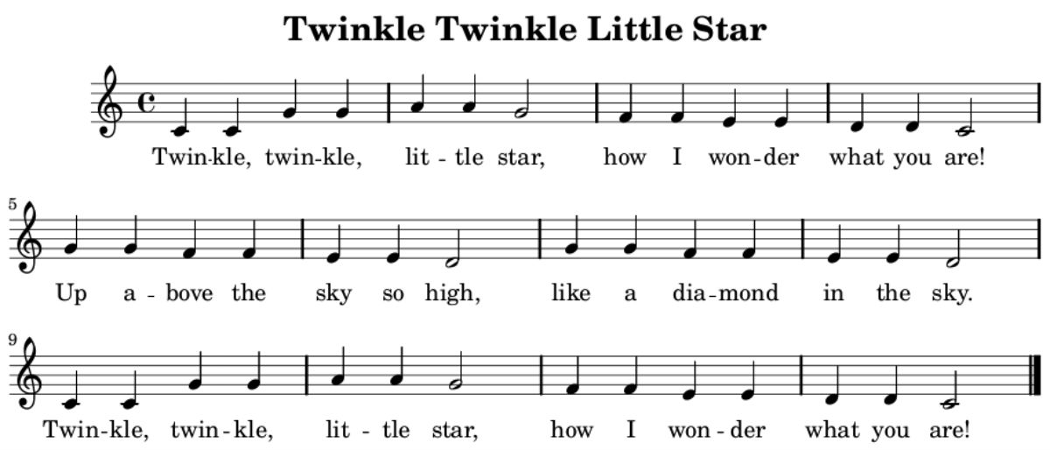
Some basic musical terms
Melody: A sequence of single tones, which a listener perceives as a single entity.
Notes:
Give definition… here we have a basic melody well known to a lot of people. I am sure that it anyone here can sing what is on this page even if you can’t read music.

Slide 4

Pitch: The quality that makes it possible to judge sounds as “higher” or “lower.”
Notes:
Next is pitch, which we dictate by the lines and spaces on a staff. Perception of pitch is relative so to standardize, we assign a fixed wave frequency to each line and space.

Slide 5
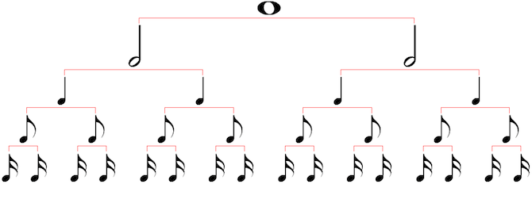
Duration: How long a note lasts.
Notes:
Duration is simply how long a note lasts. To the right is a duration tree. Assuming quadruple meter, which means that there are four beats to a measure (which is a musical unit of time), then a whole note at the top of the tree splits is comprised of two half notes, each of which contains 4 quarter notes, and then further divides into eighth note and sixteenths. The division does keep going, but we will stop labeling them there.

Slide 6
Music Production and generation
Notes:
Music production as we think of it today is the process of putting melodies and harmonies together often by means of computer production software and studio tools, but what we will talk about today is music generation, specifically the generation of melodies by computer programs, not by human tinkering.

Slide 7
Brief history of music generation
Australia’s Council for Scientific and Industrial Research (CSIR) installed a speaker to track the progress of running a program.
Geoff Hill programmed a computer to playback a tune in 1951
Illiac Suite – Composed by a computer at University of Illinois at Urbana-Champaign, 1950s
Max Mathews develops MUSIC III, which synthesizes sounds on an IBM 7094 computer.
Notes:
Going off of that, some of the background that music generation has begins in the 1940s with Australia’s Council for Scientific and Industrial Research which used sound to track the process of running a program. In the early 50s, Geoff Hill programmed a computer to playback a tune given to it by a user, which today is a task so menial for a computer we don’t think about how revolutionary it was at the time it emerged. In the same decade, researchers at the University of Illinois at Urbana-Champaign programmed a computer to compose the Illiac Suite, which is a four-movement piece with each movement being produced by a different experiment. And also (I try not to say finally because there is nothing final about it), Max Mathews developed MUSIC III in 1957 which synthesizes sounds on an IBM 7094 computer which looks like…

Slide 8
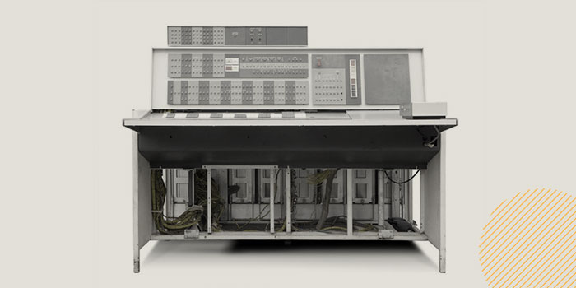
IBM 7094

Slide 9
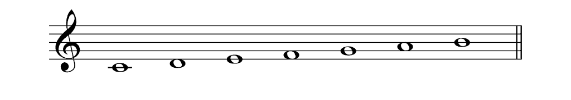
Classical computer algorithms
C4
D4
E4
F4
G4
A4
B4
Notes:
Now we will begin talking about computing algorithms. A widely used approach to programming classical computers to compose music is setting up a system where, given a scale (for example, the C4 major shown here) notes are randomly generated based on a probability model. Using a Gaussian function, the system can be biased towards picking notes in the middle of the scale, like F4 and G4 in this instance.

Slide 10

Gaussian function
$$g\left(x\right)=\frac{1}{σ\sqrt{2π}}\exp\left(\frac{−{\left(x−μ\right)}^{2}}{2σ^{2}}\right)$$
Notes:
A Gaussian function when used to represent the probability distribution of a random variable is given by the function here with expected value “mu” and variance “sigma-squared.” But a more widely used model that can aid in making a more sonorous piece is a Markov chain, where the probability of a note depends only on the note before it.

Slide 11
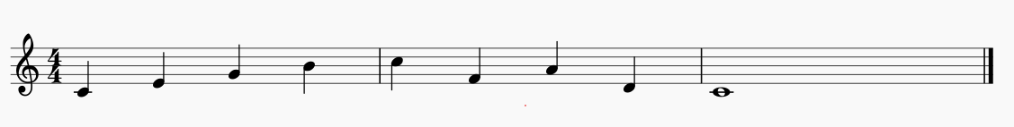

Choosing notes – markov chain
1
2
Rule 1: If C4, then E4, G4, or A4
Rule 2: If D4, then C4 or F4
Rule 3: If E4, then G4
Rule 4: If F4, then A4 or D4
Rule 5: If G4, then C4 or B4
Rule 6: If A4, then B4 or D4
Rule 7: If B4, then C5
Rule 8: If C5, then F4 or E4.
9
3
7
4
8
5
6
Notes:
This is a Markov chain that I have created to demonstrate the process of choosing notes in this method by a classical computer. Here we have eight rules the are executed based on what note is current. So rule 1 says that if the current note is C4, then the next note can be E4, G4, or A4. From the available options, the computer would randomly pick the next note. Let’s do an example… I will choose the first note and make decisions as if I were the computer, but keep in mind that I know which notes I am going to choose since I have pre-thought this example. Also, by Western standard and practice, I should start on the tonic, that is the root note, of the scale, so I will do that, but certainly the Western idea of classical music is not the only way to approach this.

Slide 12
Some Problems with quantum computing approaches
Algorithms are different than in classical computing
No cloning principle – A quantum system can not be replicated.
Notes:
As we move into a quantum approach, we need to acknowledge some problems. Since quantum states can not be observed without collapsing and because a quantum system cannot be replicated per the no-cloning principle, we cannot replicate a system from previous steps in an algorithm. In the upcoming example, however, there is some information we can store in classical memory. Now let’s finally look at the quantum approach to music generation.

Slide 13
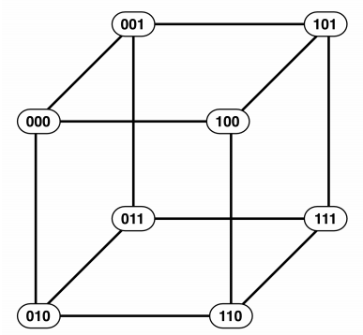
Quantum Walk Sequencer
Notes:
Classically, at any given time, we are on one note. However, in a quantum walk, we can be on all possible notes. So in the example of rule 1 in the Markov chain, we can be on C4, E4, G4 and A4 at the same time. Researchers at the University of Plymouth have set up a system that takes advantage of this mechanism. The system contains a server and a client that is accessed through an SSH. The server runs the algorithm and sends measurements to the client. The client turns those measurements into musical notes and encodes them as a MIDI file, which is a file type that allows visualization of the music with a third-party application. The quantum walk algorithm can be summarized like this… Imagine a cube. Each of the vertices is represented by a three bit long binary number. Three qubits are used to represent the vertices (call these q0, q1, and q2) and two qubits are used to represent possible routes that can be taken by the metaphorical “walker” following the algorithm (call these q3 and q4). As you can see, each vertex is connected to three other vertices that vary by one bit from the given bit. So there are four possible outputs for the computer.

Slide 14
Quantum walk sequencer
Input with q0 inverted
Input with q1 inverted
Input with q2 inverted
Input unchanged
Notes:
I find it incredibly hard to explain how the quantum walk circuit itself works, but what is essentially happening is that the q0, q1, and q2 are set up to be a state representing each one of the three edges of the cube that lead from a given vertex to another. These are measured and stored in classical memory and the two other qubits q3 and q4 are set up in superposition. Depending on the measurement of q3 and q4 (which is not stored), q0, 1, and 2 will be inverted accordingly.

Slide 15
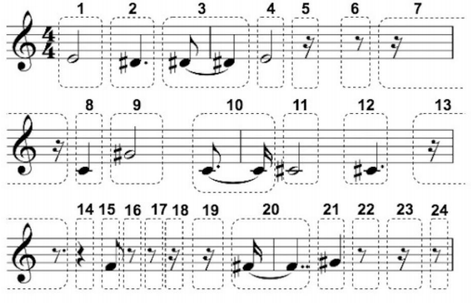
How Does it become music?
Notes:
At the beginning, the system is given a pitch and a duration. Both the pitch and the duration have a three-bit binary number assigned to them. For every note, the circuit runs twice: once to choose a pitch and once to choose a duration. This is then the set up to run the measurements again for the next note. If the “walker” lands on one of the four pause binary numbers, then the pitch is discarded and there is silence for the duration indicated by the circuit round that chooses a duration. The University of Plymouth researchers have run this quantum walk sequencer and this is the output piece. Each number indicates one output of pitch and duration. Here is what it sounds like…

Slide 16
In conclusion…
There is still a lot to be discovered.
Limitations exist
Resources
Money
Knowledge
Notes:
Quantum computing is still young, and thus figuring out its applications is still young. From what I could find, the only intense research being done on the musical applications of quantum computing is at the University of Plymouth in the United Kingdom. Limitations come from there being 15 publicly available quantum computers in the world and not much funding for research. Hopefully, though, as we learn more about how quantum computers work, researchers will be able to do and discover a lot more.

